Slide 1

CS 584 Machine Learning
Week 7
February 27, 2019

Slide 2

Week 7 Agenda: Logistic Regression
Multinomial Logistic Model
Model Structure
Estimation Algorithm
Interpretation of Parameters
Odds and Odds Ratio
Describe the impact on the target when a predictor changes
Section 10.7 of the Machine Learning book

Slide 3
Using Categorical Variables in CART
Build a classification tree using the data claim_history.csv
Target Variable is CAR_USE (Car Usage)
Categories are: Commercial and Private
Two predictors are considered, they are
OCCUPATION: a nominal variable and the categories are: Blue Collar, Clerical, Doctor, Home Maker, Lawyer, Manager, Professional, Student, and Unknown
EDUCATION: an ordinal variable and the categories are: Below High School (1), High School (2), Bachelors (3), Masters (4), and PhD (5)

Slide 4
Using Categorical Variables in CART
# Convert the EDUCATION ordinal variable into numeric variable
ord_EDU1 = numpy.where(trainData['EDUCATION'].str.strip() == "Below High School", 1, 0)
ord_EDU2 = numpy.where(trainData['EDUCATION'].str.strip() == "High School", 2, 0)
ord_EDU3 = numpy.where(trainData['EDUCATION'].str.strip() == "Bachelors", 3, 0)
ord_EDU4 = numpy.where(trainData['EDUCATION'].str.strip() == "Masters", 4, 0)
ord_EDU5 = numpy.where(trainData['EDUCATION'].str.strip() == "PhD", 5, 0)
ord_EDUCATION = ord_EDU1 + ord_EDU2 + ord_EDU3 + ord_EDU4 + ord_EDU5
# Convert the OCCUPATION nominal variable into dummy variables
cat_occupation = trainData[['OCCUPATION']].astype('category')
occupation_inputs = pandas.get_dummies(cat_occupation)
# Join the columns to create the matrix of input predictors
X_inputs = pandas.DataFrame({'ord_EDUCATION': ord_EDUCATION})
X_inputs = X_inputs.join(occupation_inputs)
X_inputs_name = X_inputs.columns.values.tolist()
Week 7 Claim_History CART.py

Slide 5
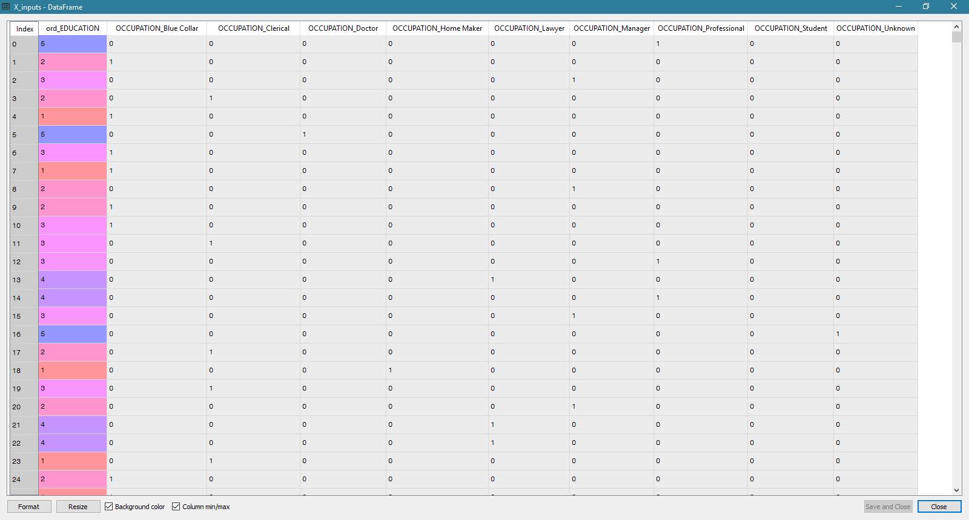
The X_inputs Data Frame

Slide 6
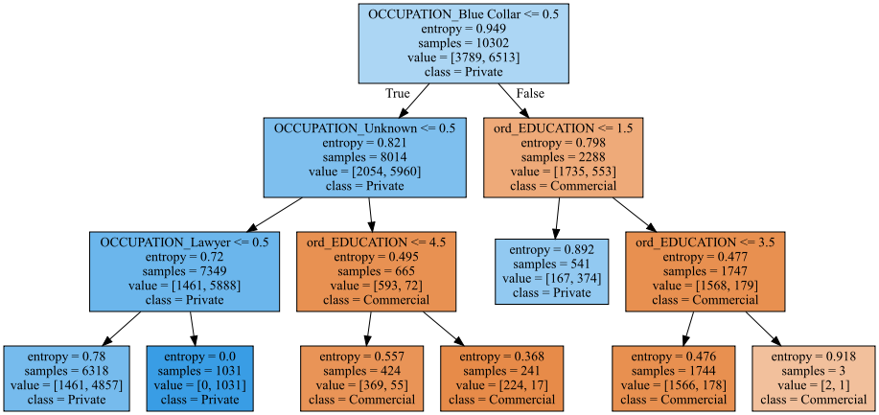
The Classification Tree (82% Accuracy)

Slide 7
Description of Tree Nodes
OCCUPATION | EDUCATION | N
 |  | Commercial | Private | Total
Clerical, Doctor, Home Maker, Manager, Professional, Student |  | 1461 | 4857 | 6318
Lawyer |  | 0 | 1031 | 1031
Unknown | Below High School (1), High School (2), Bachelors (3), Masters (4) | 369 | 55 | 424
Unknown | PhD (5) | 224 | 17 | 241
Blue Collar | Below High School (1) | 167 | 374 | 541
Blue Collar | High School (2), Bachelors (3) | 1566 | 178 | 1744
Blue Collar | Masters (4), PhD (5) | 2 | 1 | 3

Slide 8
Predicted Probabilities
OCCUPATION | EDUCATION | N
 |  | Commercial | Private | Total
Clerical, Doctor, Home Maker, Manager, Professional, Student |  | 0.23 | 0.77 | 1
Lawyer |  | 0.00 | 1.00 | 1
Unknown | Below High School (1), High School (2), Bachelors (3), Masters (4) | 0.87 | 0.13 | 1
Unknown | PhD (5) | 0.93 | 0.07 | 1
Blue Collar | Below High School (1) | 0.31 | 0.69 | 1
Blue Collar | High School (2), Bachelors (3) | 0.90 | 0.10 | 1
Blue Collar | Masters (4), PhD (5) | 0.67 | 0.33 | 1

Slide 9
Sorted Probabilities for Commercial Car Use
OCCUPATION | EDUCATION | N
 |  | Commercial | Private | Total
Lawyer |  | 0.00 | 1.00 | 1.00
Clerical, Doctor, Home Maker,Manager, Professional, Student |  | 0.23 | 0.77 | 1.00
Blue Collar | Below High School (1) | 0.31 | 0.69 | 1.00
Blue Collar | Masters (4), PhD (5) | 0.67 | 0.33 | 1.00
Unknown | Below High School (1), High School (2), Bachelors (3), Masters (4) | 0.87 | 0.13 | 1.00
Blue Collar | High School (2), Bachelors (3) | 0.90 | 0.10 | 1.00
Unknown | PhD (5) | 0.93 | 0.07 | 1.00

Slide 10
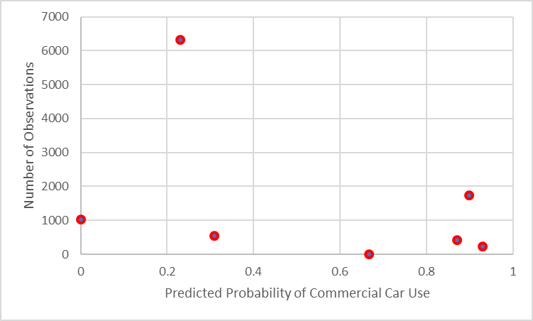
A Few Picky Comments
The predicted probabilities are so discrete. In particular, 6318 (or 61%) of data are assigned a 23% probability of commercial car use. Another 17% have a 90% probability.
We cannot evaluate the leverage of a particular occupation (e.g., Lawyer or Unknown) on the predicted probabilities.

Slide 11
Rule-Based Model vs Parametric Model
Decision Tree is an example of a Rule-Based Model
Predicted probabilities are computed based on ranges of predictors
For example, 21 ≤ AGE < 25 or CAR_TYPE in ('SUV', 'Sedan', 'Truck')
Predicted probabilities change in steps whose sizes may have no relationship to values of the predictors
Logistic Model is an example of a Parametric Model
Predicted probabilities are computed based on mathematical formulas
Can know how these probabilities change as predictors’ values change

Slide 12
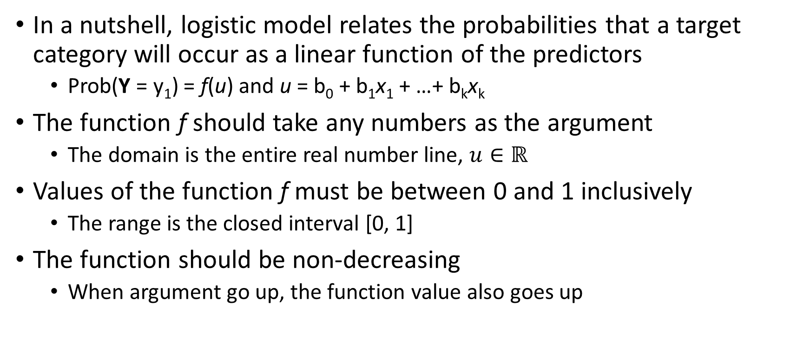
Logistic Model
In a nutshell, logistic model relates the probabilities that a target category will occur as a linear function of the predictors
Prob(Y = y₁) = f(u) and u = b₀ + b₁x₁ + …+ b_{k}x_{k}
The function f should take any numbers as the argument
The domain is the entire real number line, $u∈ℝ$
Values of the function f must be between 0 and 1 inclusively
The range is the closed interval [0, 1]
The function should be non-decreasing
When argument go up, the function value also goes up

Slide 13
Three Types of Logistic Model
Type of Logistic Model | Type of Target Variable | Example of Target Variable
Binary logistic model | Binary Categorical Two unique values | Loan Default: No Yes
Multinomial logistic model | Nominal Categorical Any number of unique values | US credit card network: American Express Discover MasterCard Visa
Ordinal logistic model | Ordinal Categorical Any number of unique values Explicit numerical, lexical, or contextual order among values | FICO score range: No Score Deep Subprime (< 620) Core Subprime (620 – 659) Prime (660-719) Superprime (≥ 720)

Slide 14
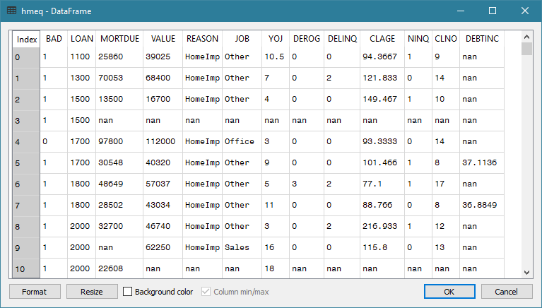
Multinomial Logistic (MNL): Data
How can we observe the occurrence likelihood of a BAD loan?
If we look at each observation, the likelihood is either 0% or 100%
What about if we look at groups of observations with identical predictors?

Slide 15
MNL: Subpopulation
We observed the occurrence likelihood by aggregating the data by the predictors that might be in the model.
Target:
BAD: Loan in default (0=No, 1=Yes), binary
Predictors:
REASON: Reason for getting the loan, (DebtCon=debt consolidation, HomeImp=home improvement), categorical
JOB: Job type (Mgr=manager, Office=office worker, Other, ProfExe=professional or executive, Sales, Self=self employed), categorical
DEROG: The number of derogatory inquiries (0+), interval

Slide 16
MNL: Subpopulation
Percent Table:
BAD 0 1 All
REASON
DebtCon 81.033605 18.966395 100.0
HomeImp 77.752809 22.247191 100.0
All 80.010512 19.989488 100.0
Group observations by REASON
REASON = DebtCon, the likelihood of BAD = 1 is 18.966395 / 19.989488 = 0.95 times of the overall
REASON = HomeImp, the likelihood of BAD = 1 is 22.247191 / 19.989488 = 1.11 times of the overall
Group observations by JOB
JOB = Office, the likelihood of BAD = 1 is 13.185654 / 20.524556 = 0.64 times of the overall
JOB = Self, the likelihood of BAD = 1 is 30.051813 / 20.524556 = 1.46 times of the overall
Question: Why the overall BAD=1 percents are different between REASON and JOB?
Percent Table:
BAD 0 1 All
JOB
Mgr 76.662321 23.337679 100.0
Office 86.814346 13.185654 100.0
Other 76.800670 23.199330 100.0
ProfExe 83.385580 16.614420 100.0
Sales 65.137615 34.862385 100.0
Self 69.948187 30.051813 100.0
All 79.475444 20.524556 100.0

Slide 17
MNL: Subpopulation
Group observations by REASON and JOB
REASON = HomeImp and JOB = Office, the likelihood of BAD = 1 is 10.963455 / 20.375723 = 0.54 of the overall
REASON = DebtCon and JOB = Mgr or Other, the likelihood of BAD = 1 is practically the same as the overall
REASON = DebtCon and JOB = Self, the likelihood of BAD = 1 is 43.835616 / 20.375723 = 2.2 times of the overall
Percent Table:
BAD 0 1 All
REASON JOB
DebtCon Mgr 79.720280 20.279720 100.0
Office 85.161290 14.838710 100.0
Other 79.239401 20.760599 100.0
ProfExe 84.769776 15.230224 100.0
Sales 64.948454 35.051546 100.0
Self 56.164384 43.835616 100.0
HomeImp Mgr 67.816092 32.183908 100.0
Office 89.036545 10.963455 100.0
Other 71.368715 28.631285 100.0
ProfExe 81.975309 18.024691 100.0
Sales 66.666667 33.333333 100.0
Self 81.739130 18.260870 100.0
All 79.624277 20.375723 100.0

Slide 18
MNL: Subpopulation
Percent Table:
BAD 0 1 All
REASON JOB DEROG
DebtCon Mgr 0.0 82.425743 17.574257 100.0
1.0 68.965517 31.034483 100.0
2.0 40.909091 59.090909 100.0
3.0 0.000000 100.000000 100.0
4.0 0.000000 100.000000 100.0
7.0 0.000000 100.000000 100.0
8.0 0.000000 100.000000 100.0
Office 0.0 88.376754 11.623246 100.0
1.0 50.000000 50.000000 100.0
2.0 46.666667 53.333333 100.0
3.0 0.000000 100.000000 100.0
Other 0.0 81.712386 18.287614 100.0
1.0 57.692308 42.307692 100.0
2.0 65.957447 34.042553 100.0
3.0 50.000000 50.000000 100.0
4.0 71.428571 28.571429 100.0
5.0 100.000000 0.000000 100.0
6.0 62.500000 37.500000 100.0
7.0 0.000000 100.000000 100.0
8.0 0.000000 100.000000 100.0
9.0 0.000000 100.000000 100.0
10.0 0.000000 100.000000 100.0
ProfExe 0.0 87.352941 12.647059 100.0
1.0 76.923077 23.076923 100.0
2.0 37.500000 62.500000 100.0
3.0 22.222222 77.777778 100.0
4.0 0.000000 100.000000 100.0
6.0 0.000000 100.000000 100.0
7.0 0.000000 100.000000 100.0
Sales 0.0 72.000000 28.000000 100.0
... ... ...
All 78.939972 21.060028 100.0
What about the interval predictors?
We will aggregate the data by distinct values of BAD, REASON, JOB, and DEROG.
Even though DEROG is an interval variable, we will treat it as a categorical variable only for the purpose of aggregation.

Slide 19
MNL: Subpopulation
Subpopulations are defined by the observed cross-classifications of distinct values of predictors (i.e., input variables).
For example, if REASON (categorical), JOB (categorical), DEROG (interval) are predictors, then examples of subpopulations are:
Reason = DebtCon, JOB = Mgr, and DEROG=0
REASON = DebtCon, JOB = ProfExe, and DEROG=6
REASON = HomeImp, JOB = Office, DEROG=2
Subpopulations are user-defined disjoint partitions of the data

Slide 20
MNL: Subpopulation
Observations are aggregated within each subpopulation to obtain the empirical distribution of categories of the target variable.
Suppose $n_{ij}≥0$ is the number of observations in the j^{th} category of the target variable in the i^{th} subpopulation.
Let $n_{i}=\sum_{j=1}^{K}{n_{ij}}$ be the marginal number of observations in the i^{th} subpopulation. It is assumed $n_{i}>0$, otherwise, the subpopulation could not be observed.
Example, this combination: REASON = DebtCon, JOB = Office, DEROG=4 is not a subpopulation because this combination is not observed.

Slide 21
MNL: Parameter Coding for Categorical Predictor
The dummy coding (a.k.a. GLM or over-parametrized coding) is to create a binary column whose values are: 0 or 1 for each category of a categorical predictor.
The pandas.get_dummies() function can generate dummy columns
MNL does not distinguish between nominal and ordinal predictors, both types are considered as categorical predictors.
If the categorical predictor has p categories, then p binary dummy columns are created.

Slide 22
MNL: Parameter Coding for Categorical Predictor
REASON has two categories. The two binary columns are:
REASON_Debtcon = 1 if REASON = ‘DebtCon’, 0 otherwise
REASON_HomeImp = 1 if REASON = ‘HomeImp’, 0 otherwise.
JOB has six categories. The six binary columns are:
JOB_Mgr = 1 if JOB = ‘Mgr’, 0 otherwise
JOB_Office = 1 if JOB = ‘Office’, 0 otherwise
JOB_Other = 1 if JOB = ‘Other’, 0 otherwise
JOB_ProfExe = 1 if JOB = ‘ProfExe’, 0 otherwise
JOB_Sales = 1 if JOB = ‘Sales’, 0 otherwise
JOB_Self = 1 if JOB = ‘Self’, 0 otherwise

Slide 23
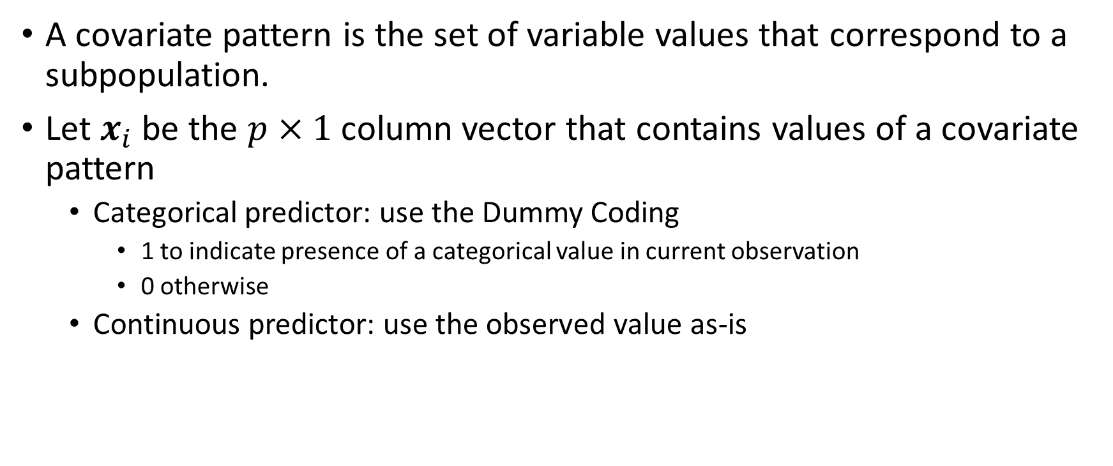
MNL: Covariate Pattern
A covariate pattern is the set of variable values that correspond to a subpopulation.
Let $x_{i}$ be the $p×1$ column vector that contains values of a covariate pattern
Categorical predictor: use the Dummy Coding
1 to indicate presence of a categorical value in current observation
0 otherwise
Continuous predictor: use the observed value as-is

Slide 24
MNL: Covariate Pattern
The subpopulation: REASON = DebtCon, JOB = Mgr, and DEROG = 0 will produce this covariate pattern:
REASON_DebtCon = 1, REASON_HomeImp = 0, JOB_Mgr = 1, JOB_Office = 0, JOB_Other = 0, JOB_ProfExe = 0, JOB_Sales = 0, JOB_Self = 0, DEROG = 0
The subpopulation: REASON = HomeImp, JOB = ProfExe, and DEROG = 6 will produce this covariate pattern:
REASON_DebtCon = 0, REASON_HomeImp = 1, JOB_Mgr = 0, JOB_Office = 0, JOB_Other = 0, JOB_ProfExe = 1, JOB_Sales = 0, JOB_Self = 0, DEROG = 6

Slide 25
MNL: Target Variable
The target variable must have $K≥2$ categories.
Assume the occurrences of the categories in each subpopulation follow a multinomial distribution, and the distributions across subpopulations are statistically independent
Let ${0≤π}_{ij}≤1$ be the probability that the j^{th} category of the target variable will be observed in the i^{th} subpopulation.
If the i^{th} subpopulation is actually observed, then some category of the target variable must also be observed. It follows:
$\sum_{j=1}^{K}{π_{ij}}=1$.
At least one probability $π_{ij}>0$.

Slide 26
MNL: Parameter
Let $β_{j}$ be the $p×1$ column vector of parameters that correspond to the predictors used in defining a covariate pattern.
There is one $β_{j}$ for each category of the target variable
Since $\sum_{j=1}^{K}{π_{ij}}=1$, we only need $K−1$ parameter vectors. Therefore, we arbitrarily set $β_{J}=0$ for the J^{th} category (a.k.a. the reference category) of the target variable.
Choice of reference category of the target variable:
A common choice is the LAST category (highest lexical order)
The preferred choice is the MODE category (largest number of observations, in case of ties, choose the lowest lexical order category)

Slide 27
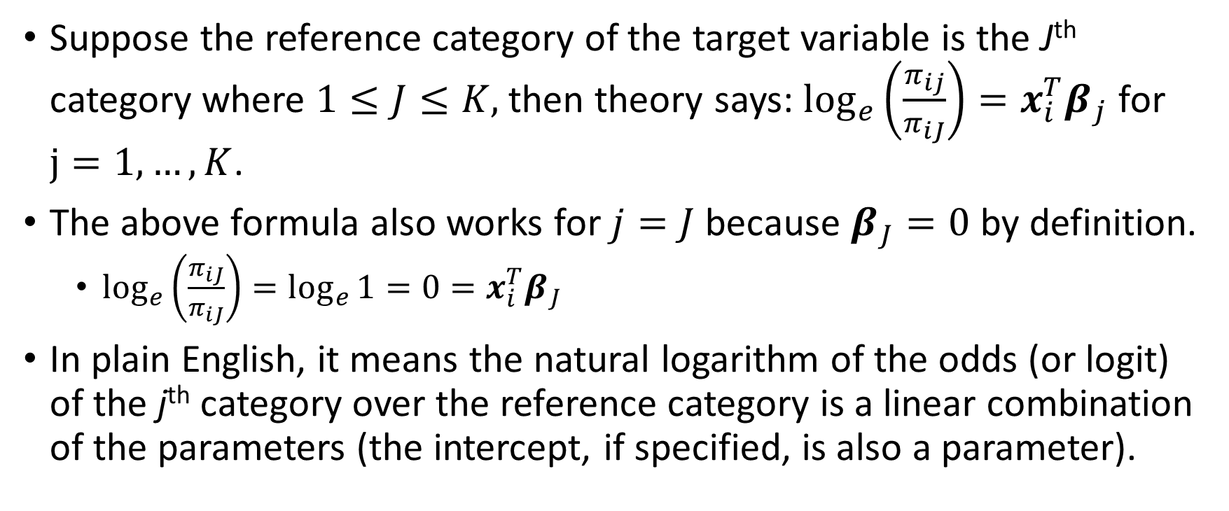
MNL: Theory
Suppose the reference category of the target variable is the J^{th} category where $1≤J≤K,$then theory says: $\log_{e}\left(\frac{π_{ij}}{π_{iJ}}\right)={x_{i}^{T}β}_{j}$ for $j=1, …,K$.
The above formula also works for $j=J$ because $β_{J}=0$ by definition.
$\log_{e}\left(\frac{π_{iJ}}{π_{iJ}}\right)=\log_{e}{1}=0={x_{i}^{T}β}_{J}$
In plain English, it means the natural logarithm of the odds (or logit) of the j^{th} category over the reference category is a linear combination of the parameters (the intercept, if specified, is also a parameter).

Slide 28
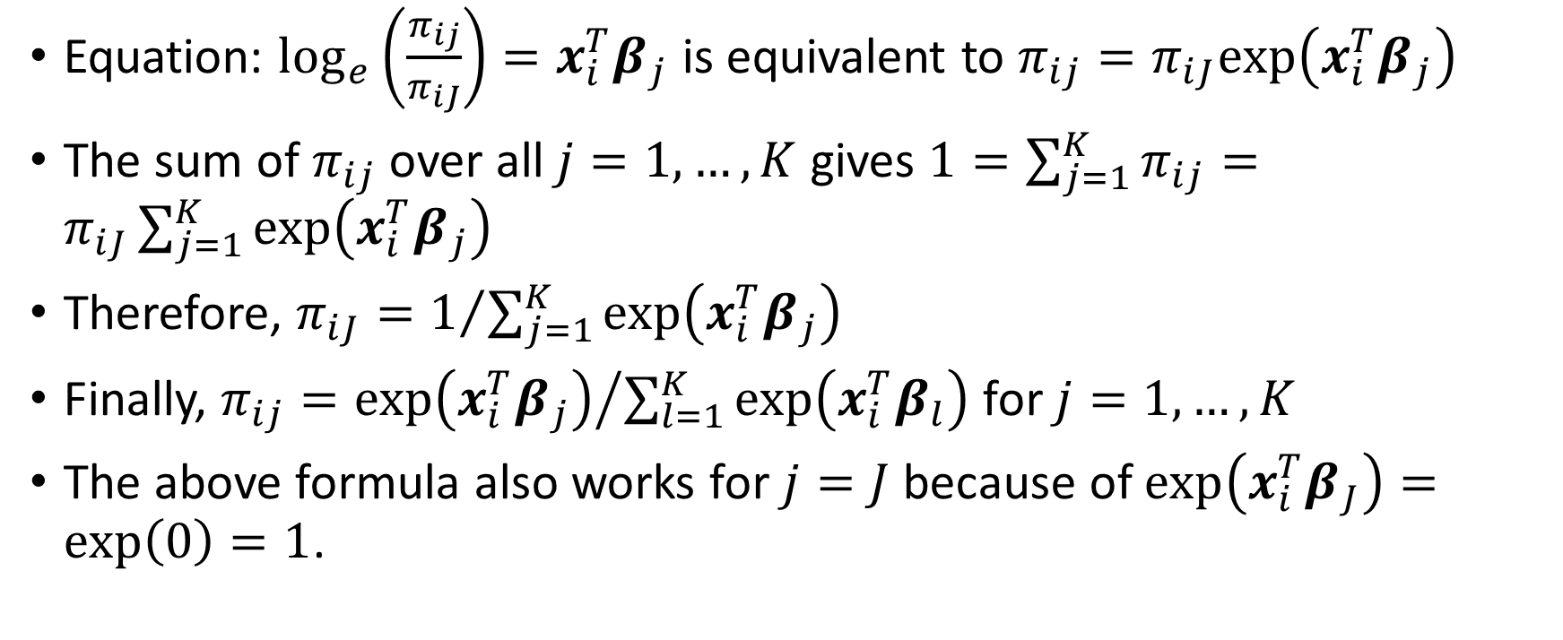
MNL: Theory
Equation: $\log_{e}\left(\frac{π_{ij}}{π_{iJ}}\right)={x_{i}^{T}β}_{j}$ is equivalent to $π_{ij}=π_{iJ}exp⁡\left({x_{i}^{T}β}_{j}\right)$
The sum of $π_{ij}$ over all $j=1,…,K$ gives $1=\sum_{j=1}^{K}{π_{ij}}=π_{iJ}\sum_{j=1}^{K}{exp⁡\left({x_{i}^{T}β}_{j}\right)}$
Therefore, $π_{iJ}=1/{\sum_{j=1}^{K}{exp⁡\left({x_{i}^{T}β}_{j}\right)}}$
Finally, $π_{ij}={exp⁡\left({x_{i}^{T}β}_{j}\right)}/{\sum_{l=1}^{K}{exp⁡\left({x_{i}^{T}β}_{l}\right)}}$ for $j=1,…,K$
The above formula also works for $j=J$ because of $\exp\left({x_{i}^{T}β}_{J}\right)=exp⁡\left(0\right)=1$.

Slide 29
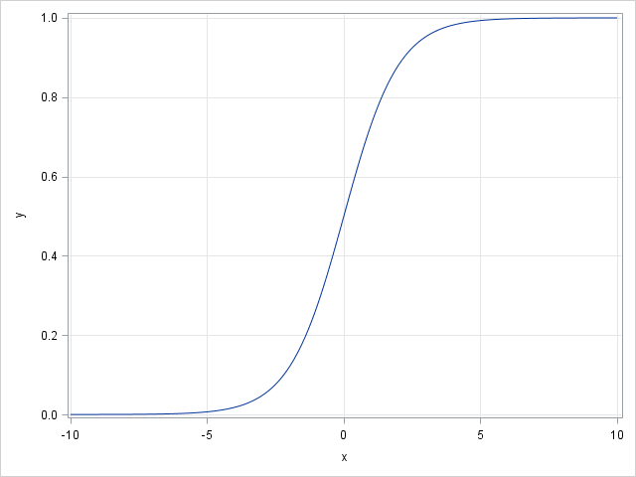
MNL: Why Logistic?
The logistic curve has the formula: $y=\frac{1}{1+e^{−x}}=\frac{e^{x}}{1+e^{x}}$ for any real x.
The range: $0≤y≤1$ for all values of $x$
It has two horizontal asymptotes:
$y=0$ as $x→−∞$ and
$y=1$ as $x→+∞$
In the middle portion of the domain, the curve appears fairly linear in x
Therefore, the curve is suitable for representing probability.

Slide 30
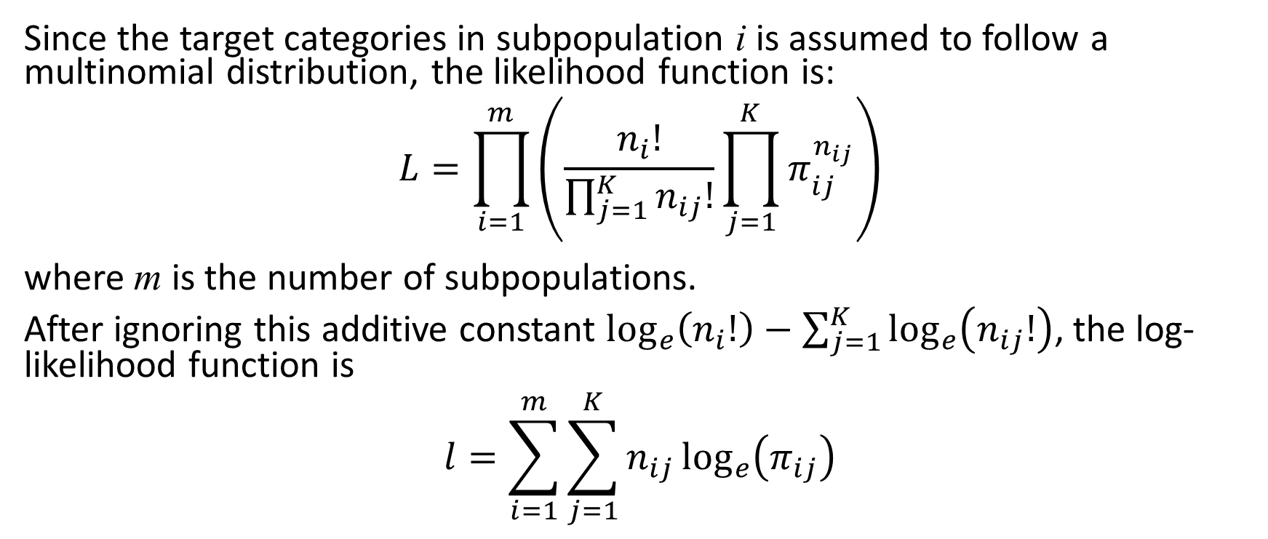
MNL: Maximum Likelihood Estimation (MLE)
Since the target categories in subpopulation i is assumed to follow a multinomial distribution, the likelihood function is: $$L=\prod_{i=1}^{m}{\left(\frac{n_{i}!}{\prod_{j=1}^{K}{n_{ij}!}}\prod_{j=1}^{K}{π_{ij}^{n_{ij}}}\right)}$$ where m is the number of subpopulations.
After ignoring this additive constant $\log_{e}\left(n_{i}!\right)−\sum_{j=1}^{K}{\log_{e}\left(n_{ij}!\right)}$, the log-likelihood function is $$l=\sum_{i=1}^{m}{\sum_{j=1}^{K}{n_{ij}\log_{e}\left(π_{ij}\right)}}$$

Slide 31
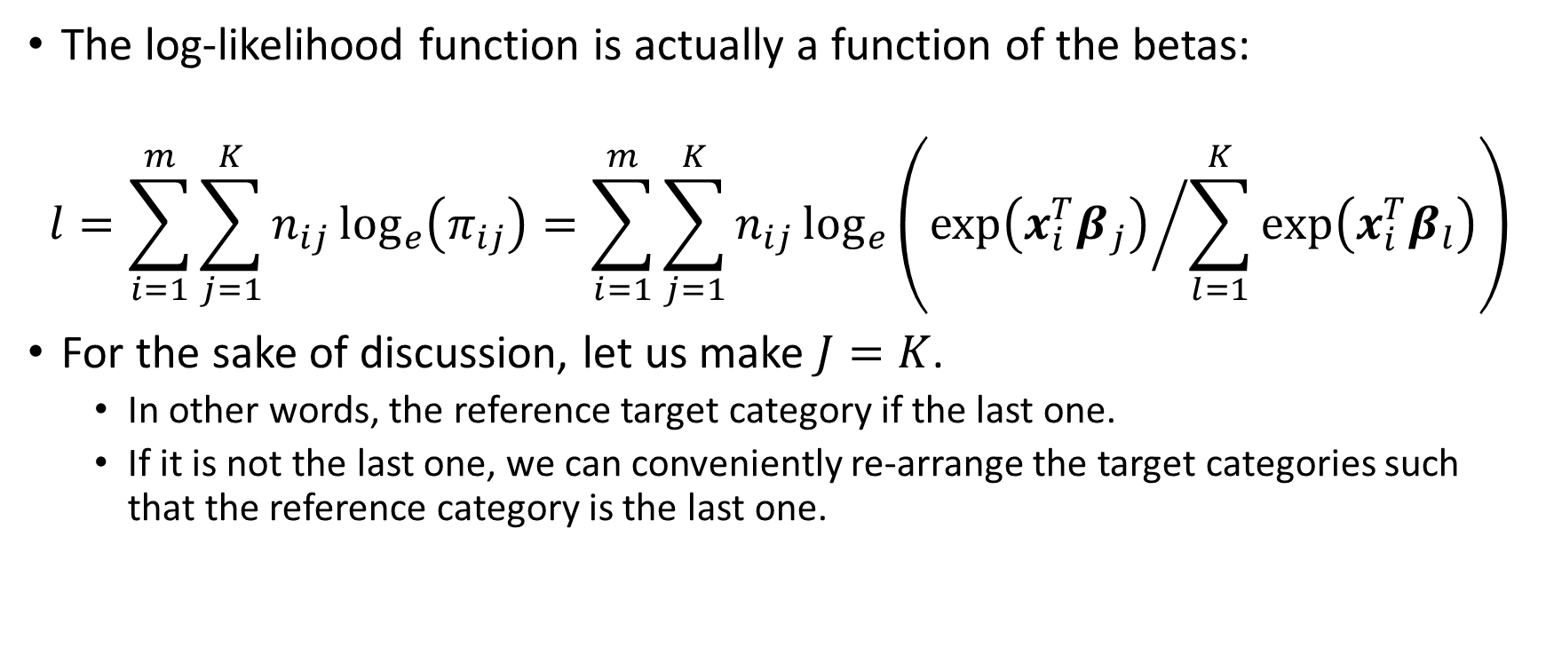
MNL: The Log-Likelihood Function
The log-likelihood function is actually a function of the betas:
$$l=\sum_{i=1}^{m}{\sum_{j=1}^{K}{n_{ij}\log_{e}\left(π_{ij}\right)}}=\sum_{i=1}^{m}{\sum_{j=1}^{K}{n_{ij}\log_{e}\left({exp⁡\left({x_{i}^{T}β}_{j}\right)}/{\sum_{l=1}^{K}{exp⁡\left({x_{i}^{T}β}_{l}\right)}}\right)}}$$
For the sake of discussion, let us make $J=K$.
In other words, the reference target category if the last one.
If it is not the last one, we can conveniently re-arrange the target categories such that the reference category is the last one.

Slide 32
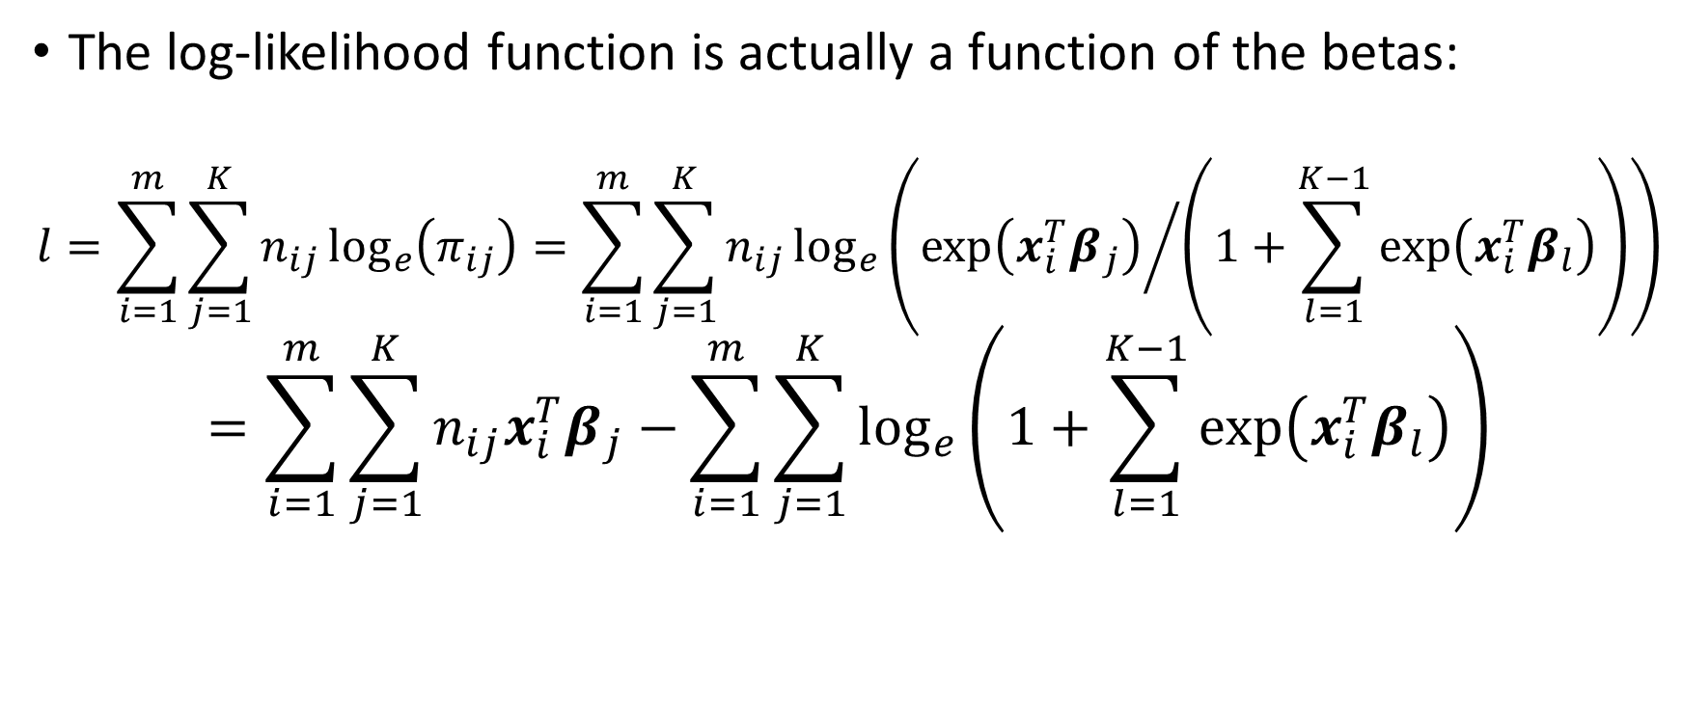
MNL: The Log-Likelihood Function
The log-likelihood function is actually a function of the betas:
$$l=\sum_{i=1}^{m}{\sum_{j=1}^{K}{n_{ij}\log_{e}\left(π_{ij}\right)}}=\sum_{i=1}^{m}{\sum_{j=1}^{K}{n_{ij}\log_{e}\left({exp⁡\left({x_{i}^{T}β}_{j}\right)}/{\left(1+\sum_{l=1}^{K−1}{exp⁡\left({x_{i}^{T}β}_{l}\right)}\right)}\right)}}$$
$$=\sum_{i=1}^{m}{\sum_{j=1}^{K}{n_{ij}{x_{i}^{T}β}_{j}−}\sum_{i=1}^{m}{\sum_{j=1}^{K}{\log_{e}\left(1+\sum_{l=1}^{K−1}{exp⁡\left({x_{i}^{T}β}_{l}\right)}\right)}}}$$

Slide 33
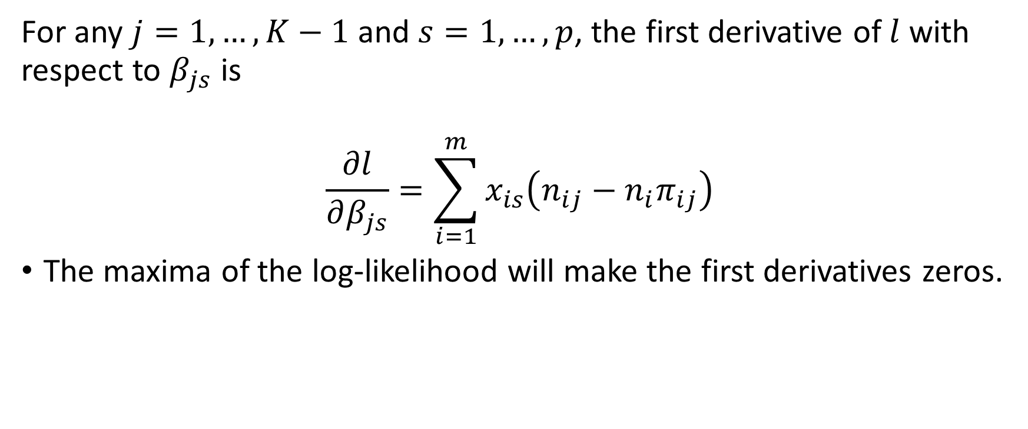
MNL: First Derivative of the Log-Likelihood Function
For any $j=1,…,K−1$ and $s=1,…,p$, the first derivative of $l$ with respect to $β_{js}$ is
$$\frac{∂l}{∂β_{js}}=\sum_{i=1}^{m}{x_{is}\left(n_{ij}−{n_{i}π}_{ij}\right)}$$
The maxima of the log-likelihood will make the first derivatives zeros.

Slide 34
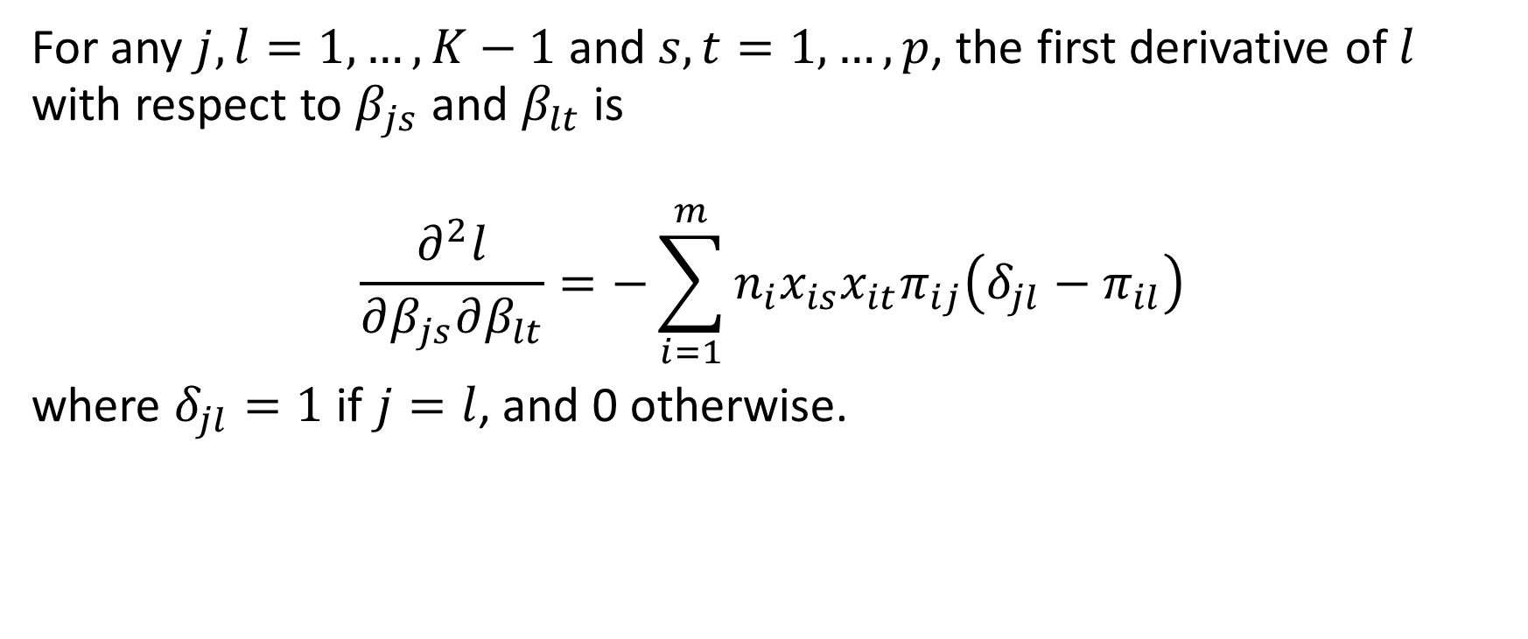
MNL: Second Derivative of the Log-Likelihood Function
For any $j,l=1,…,K−1$ and $s,t=1,…,p$, the first derivative of $l$ with respect to $β_{js}$ and $β_{lt}$ is
$$\frac{∂^{2}l}{∂β_{js}∂β_{lt}}=−\sum_{i=1}^{m}{{n_{i}x}_{is}x_{it}π_{ij}\left(δ_{jl}−π_{il}\right)}$$
where $δ_{jl}=1$ if $j=l$, and 0 otherwise.

Slide 35
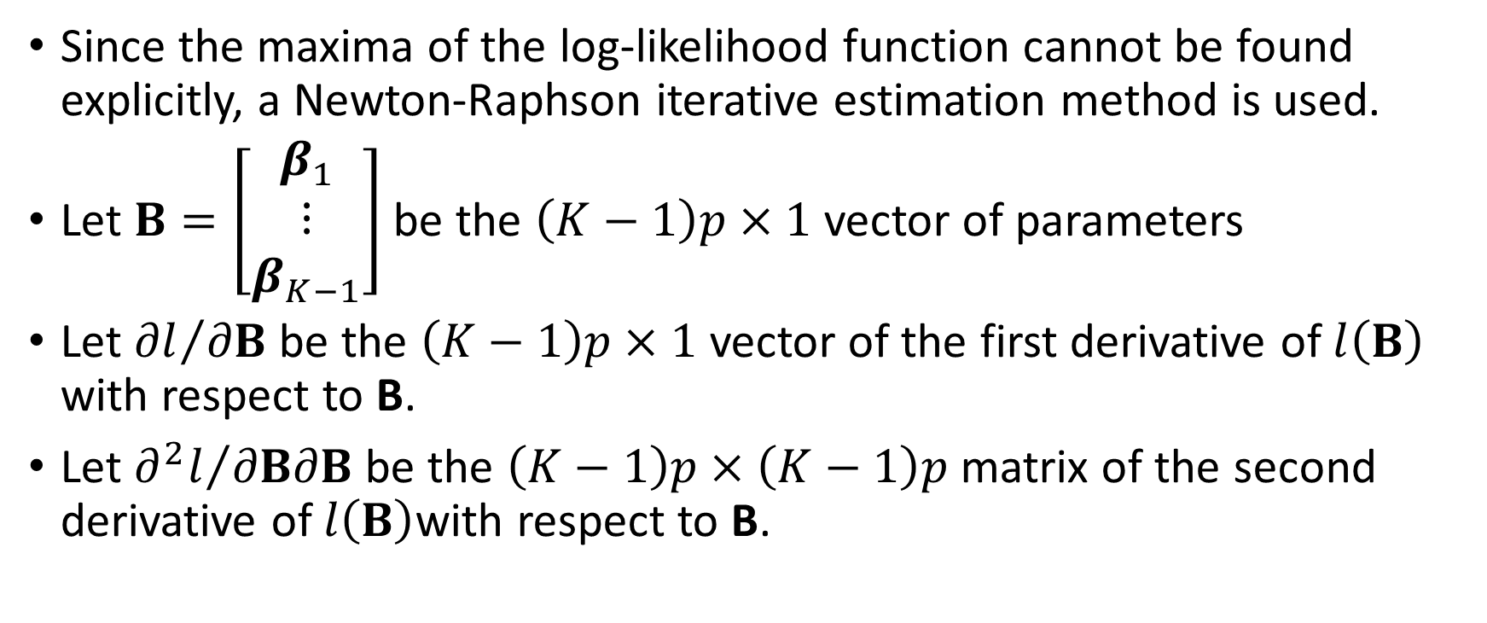
MNL: Newton-Raphson Algorithm
Since the maxima of the log-likelihood function cannot be found explicitly, a Newton-Raphson iterative estimation method is used.
Let $B=\left[\begin{matrix}β_{1} \\ ⋮ \\ β_{K−1}\end{matrix}\right]$ be the $\left(K−1\right)p×1$ vector of parameters
Let ${∂l}/{∂B}$ be the $\left(K−1\right)p×1$ vector of the first derivative of $l\left(B\right)$ with respect to B.
Let ${∂^{2}l}/{∂B∂B}$ be the $\left(K−1\right)p×\left(K−1\right)p$ matrix of the second derivative of $l\left(B\right)$with respect to B.

Slide 36
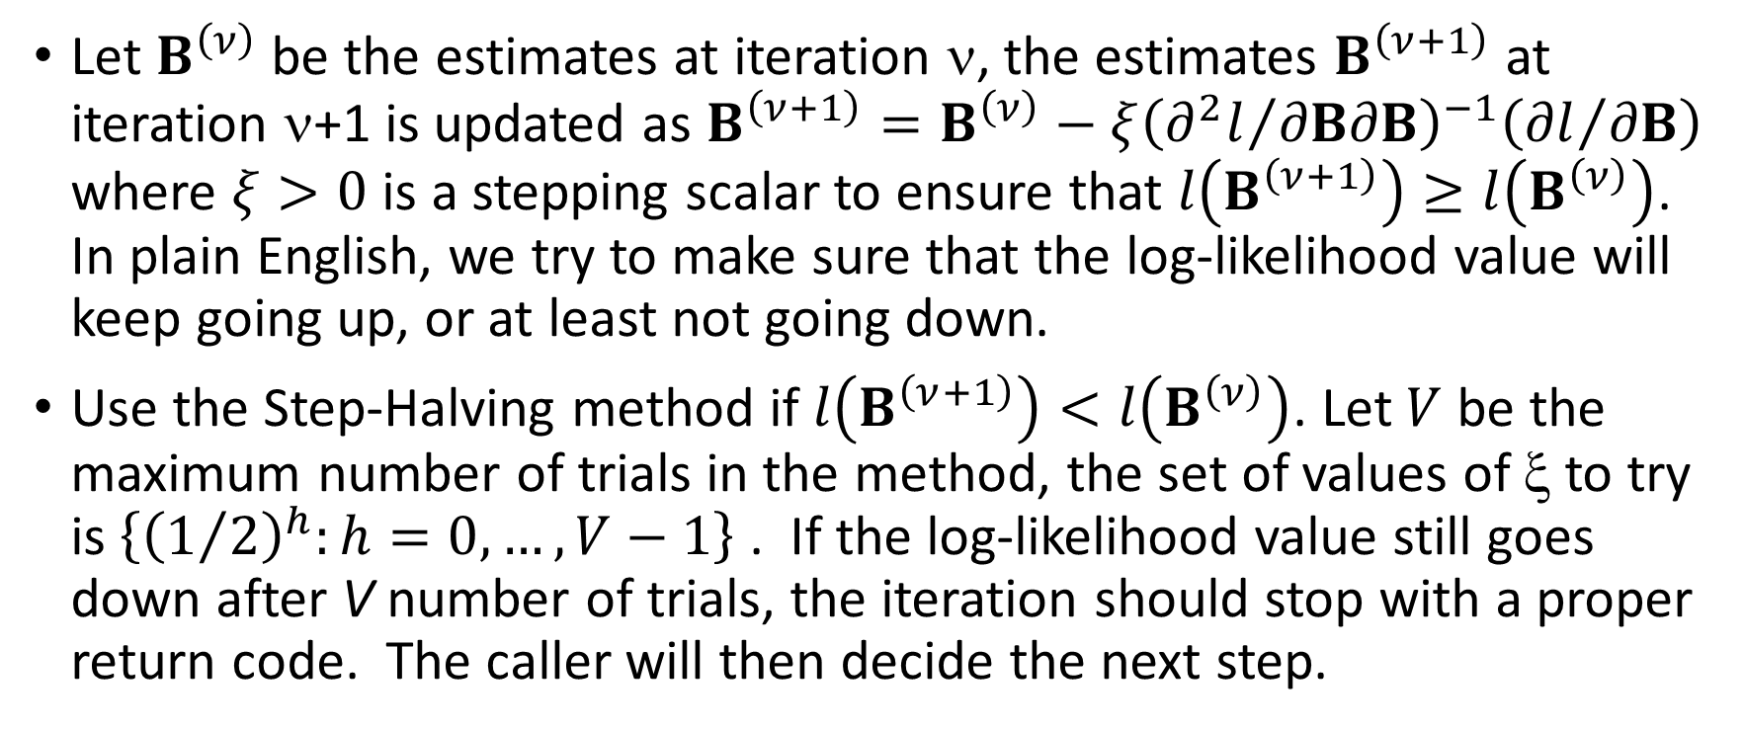
MNL: Newton-Raphson Algorithm
Let $B^{\left(ν\right)}$ be the estimates at iteration ν, the estimates $B^{\left(ν+1\right)}$ at iteration ν+1 is updated as $B^{\left(ν+1\right)}=B^{\left(ν\right)}−ξ{\left({∂^{2}l}/{∂B∂B}\right)}^{−1}\left({∂l}/{∂B}\right)$ where $ξ>0$ is a stepping scalar to ensure that $l\left(B^{\left(ν+1\right)}\right)≥l\left(B^{\left(ν\right)}\right)$. In plain English, we try to make sure that the log-likelihood value will keep going up, or at least not going down.
Use the Step-Halving method if $l\left(B^{\left(ν+1\right)}\right)<l\left(B^{\left(ν\right)}\right)$. Let $V$ be the maximum number of trials in the method, the set of values of ξ to try is $\left\{{\left(1/2\right)}^{h}:h=0,…,V−1\right\}$ . If the log-likelihood value still goes down after V number of trials, the iteration should stop with a proper return code. The caller will then decide the next step.

Slide 37
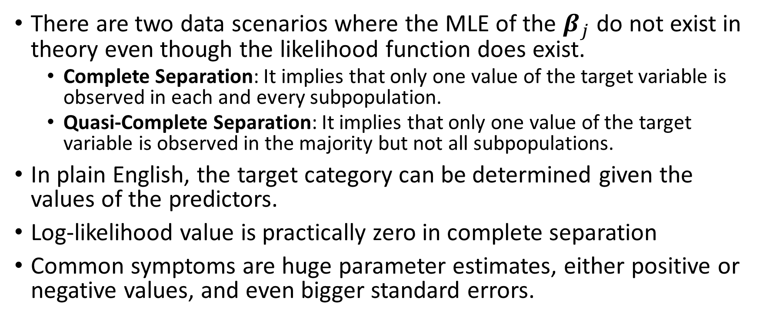
MNL: Separation
There are two data scenarios where the MLE of the $β_{j}$ do not exist in theory even though the likelihood function does exist.
Complete Separation: It implies that only one value of the target variable is observed in each and every subpopulation.
Quasi-Complete Separation: It implies that only one value of the target variable is observed in the majority but not all subpopulations.
In plain English, the target category can be determined given the values of the predictors.
Log-likelihood value is practically zero in complete separation
Common symptoms are huge parameter estimates, either positive or negative values, and even bigger standard errors.

Slide 38
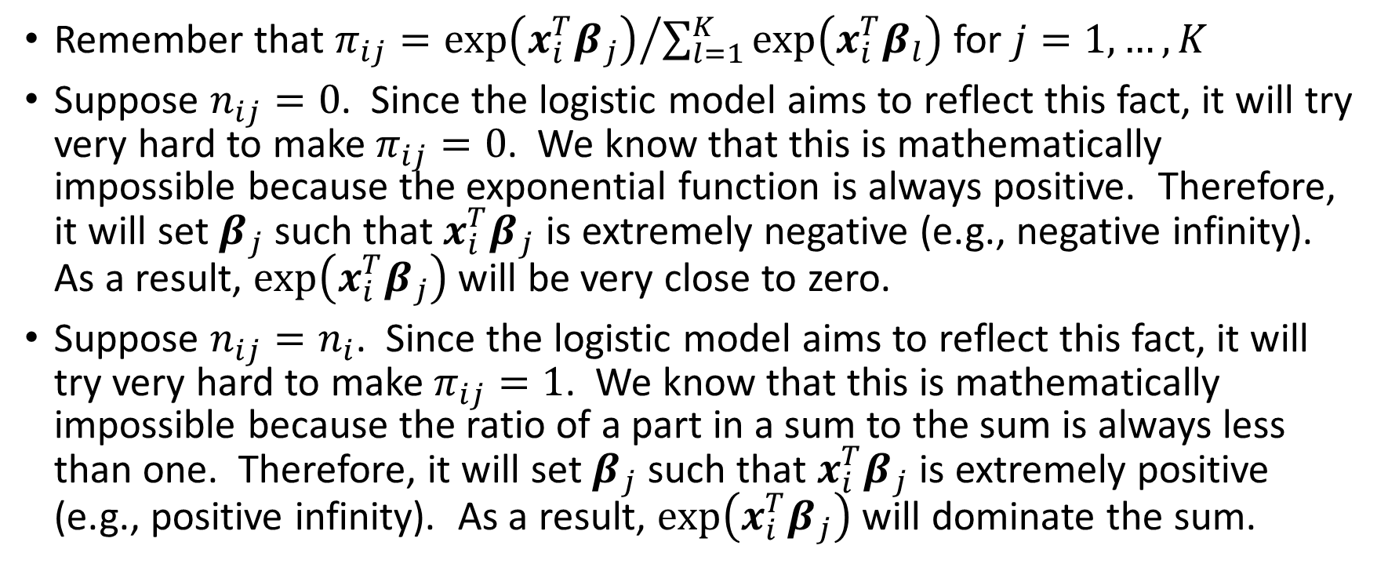
MNL: Mathematics on Separation
Remember that $π_{ij}={exp⁡\left({x_{i}^{T}β}_{j}\right)}/{\sum_{l=1}^{K}{exp⁡\left({x_{i}^{T}β}_{l}\right)}}$ for $j=1,…,K$
Suppose $n_{ij}=0$. Since the logistic model aims to reflect this fact, it will try very hard to make $π_{ij}=0$. We know that this is mathematically impossible because the exponential function is always positive. Therefore, it will set $β_{j}$ such that ${x_{i}^{T}β}_{j}$ is extremely negative (e.g., negative infinity). As a result, $exp⁡\left({x_{i}^{T}β}_{j}\right)$ will be very close to zero.
Suppose $n_{ij}=n_{i}$. Since the logistic model aims to reflect this fact, it will try very hard to make $π_{ij}=1$. We know that this is mathematically impossible because the ratio of a part in a sum to the sum is always less than one. Therefore, it will set $β_{j}$ such that ${x_{i}^{T}β}_{j}$ is extremely positive (e.g., positive infinity). As a result, $exp⁡\left({x_{i}^{T}β}_{j}\right)$ will dominate the sum.

Slide 39
MNL: Why Separation Occurs?
Used nominal predictors which have too many unique values
e.g., the Case ID, the SSN, the Employee ID
Inappropriately specified interval predictors as categorical
Included too many predictors, but not enough observations
Too many predictors → every observation produces a unique covariate pattern → only one target value is observed in the covariate pattern

Slide 40
MNL: Workarounds for Separation
Use fewer predictors, avoid interval predictors.
Consider pre-binning interval predictors and use the resulting Bin IDs as categorical predictors instead.
Use a penalized log-likelihood function with a penalty on the sum of the absolute (or squares of) parameter estimates.

Slide 41
MNL: Interpretation of Parameters
Remember: $\log_{e}\left(\frac{π_{ij}}{π_{iJ}}\right)={x_{i}^{T}β}_{j}$.
Let us consider a very simple case where there is only one predictor: x whose values are either 0 or 1
When x = 0, $\log_{e}\left(\frac{π_{ij}^{0}}{π_{iJ}^{0}}\right)=0$ which gives$\frac{π_{ij}^{0}}{π_{iJ}^{0}}=1$ or $π_{ij}^{0}=π_{iJ}^{0}$
When x = 1, $\log_{e}\left(\frac{π_{ij}^{1}}{π_{iJ}^{1}}\right)=β_{j}$ which gives$\frac{π_{ij}^{1}}{π_{iJ}^{1}}=e^{β_{j}}$ or $π_{ij}^{1}=e^{β_{j}}π_{iJ}^{1}$
When x changes from 0 to 1, the predicted odds $\frac{π_{ij}}{π_{iJ}}$ (i.e., prefer category j over category J) changes by a factor of $e^{β_{j}}$.

Slide 42
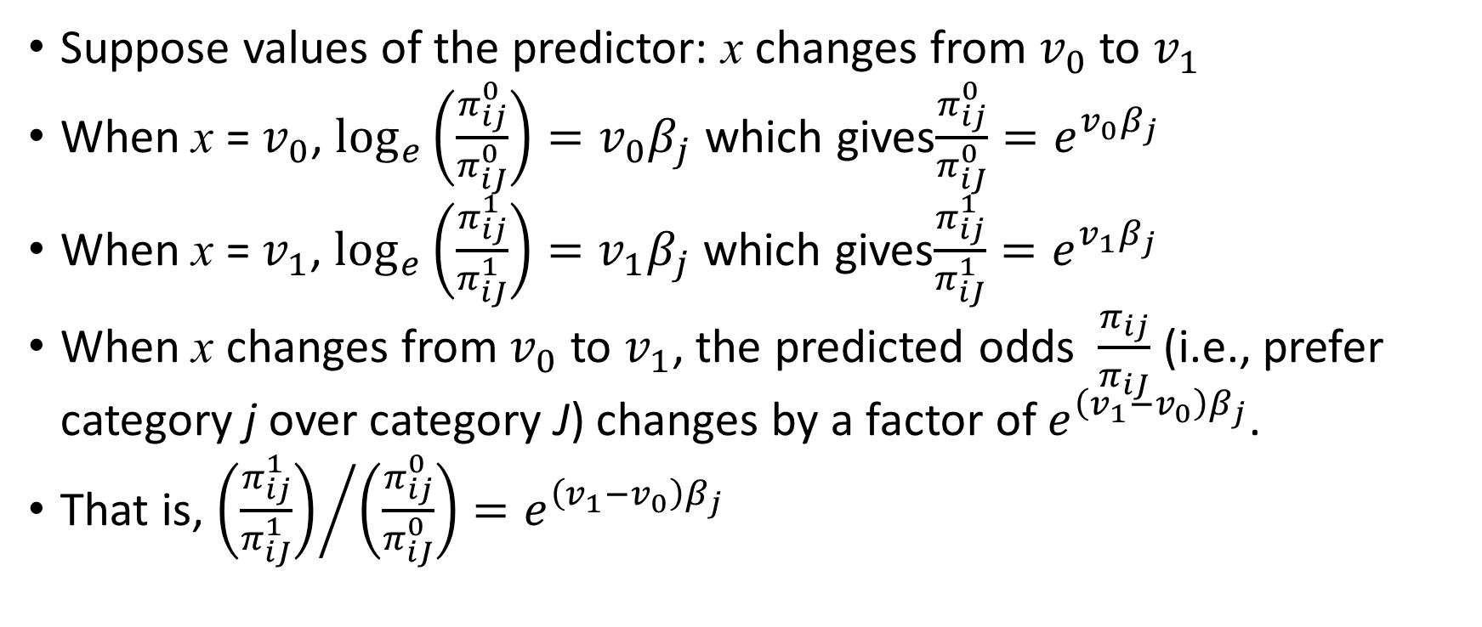
MNL: Interpretation of Parameters
Suppose values of the predictor: x changes from $v_{0}$ to $v_{1}$
When x = $v_{0}$, $\log_{e}\left(\frac{π_{ij}^{0}}{π_{iJ}^{0}}\right)=v_{0}β_{j}$ which gives$\frac{π_{ij}^{0}}{π_{iJ}^{0}}=e^{v_{0}β_{j}}$
When x = $v_{1}$, $\log_{e}\left(\frac{π_{ij}^{1}}{π_{iJ}^{1}}\right)=v_{1}β_{j}$ which gives$\frac{π_{ij}^{1}}{π_{iJ}^{1}}=e^{v_{1}β_{j}}$
When x changes from $v_{0}$ to $v_{1}$, the predicted odds $\frac{π_{ij}}{π_{iJ}}$ (i.e., prefer category j over category J) changes by a factor of $e^{{\left(v_{1}−v_{0}\right)β}_{j}}$.
That is, ${\left(\frac{π_{ij}^{1}}{π_{iJ}^{1}}\right)}/{\left(\frac{π_{ij}^{0}}{π_{iJ}^{0}}\right)}=e^{{\left(v_{1}−v_{0}\right)β}_{j}}$

Slide 43
MNL: Interpretation of Parameters
Use the CARS.CSV dataset
Predict Origin (Asia, Europe, USA) by DriveTrain (AWD, FWD, RWD)
The observed counts and row percents are below:
Finding: Front-wheel drive (FWD) cars are made mostly in Asia, while Rear- wheel drive (RWD) cars are made mostly in Europe.
Frequency Table:
Origin Asia Europe USA All
DriveTrain
AWD 34 36 22 92
FWD 99 37 90 226
RWD 25 50 35 110
All 158 123 147 428
Percent Table:
Origin Asia Europe USA All
DriveTrain
AWD 36.956522 39.130435 23.913043 100.0
FWD 43.805310 16.371681 39.823009 100.0
RWD 22.727273 45.454545 31.818182 100.0
All 36.915888 28.738318 34.345794 100.0
Week 7 Cars Logistic

Slide 44
MNL: Interpretation of Parameters
A set of parameters:
Intercept
[DriveTrain=AWD]
[DriveTrain=FWD]
[DriveTrain=RWD]
One set of parameters for
Origin=Asia
Origin=Europe
Origin=USA
Model Parameter Estimates:
0 1
const -0.058474 -0.048541
DriveTrain_AWD 0.115633 -0.386777
DriveTrain_FWD -0.925728 -0.046769
DriveTrain_RWD 0.751621 0.385013

Slide 45
MNL: Interpretation of Parameters
The parameter [DriveTrain=RWD] is linearly dependent on the previous three parameters
[DriveTrain=AWD] + [DriveTrain=FWD] + [DriveTrain=RWD] = Intercept
Instead of setting [DriveTrain=RWD] = 0, Python’s statsmodels.api.MNLogit function enforces the above constraint
[0]: -0.058474 = 0.115633 – 0.925728 + 0.751621
[1]: -0.048541 = -0.386777 – 0.046769 + 0.385013
Model Parameter Estimates:
0 1
const -0.058474 -0.048541
DriveTrain_AWD 0.115633 -0.386777
DriveTrain_FWD -0.925728 -0.046769
DriveTrain_RWD 0.751621 0.385013

Slide 46
MNL: Interpretation of Parameters
The statsmodels.api.MNLogit function conventionally takes the lexically first target category as the reference. In this case, Origin = ‘Asia’ is the reference category.
The [0] column in the Parameter Estimates actually refers to the lexically second target category, which is Origin = ‘Europe’.
The [1] column in the Parameter Estimates actually refers to the lexically third (or last) target category, which is Origin = ‘USA’.
Regardless of the convention, the meanings of the parameter estimates are expressed in terms of the logits.

Slide 47
MNL: Interpretation of Parameters
First Logit: log_{e}(Pr(Origin=Europe)/Pr(Origin=Asia)) = Intercept(Europe) + [DriveTrain=AWD](Europe) + [DriveTrain=FWD](Europe) + [DriveTrain=RWD](Europe)
DriveTrain=AWD: log_{e}(Pr(Europe)/Pr(Asia)) = Intercept(Europe) + [DriveTrain=AWD](Europe)
DriveTrain=FWD: log_{e}(Pr(Europe)/Pr(Asia)) = Intercept(Europe) + [DriveTrain=FWD](Europe)
DriveTrain=RWD: log_{e}(Pr(Europe)/Pr(Asia)) = Intercept(Europe) + [DriveTrain=RWD](Europe)
Second Logit: log_{e}(Pr(Origin=USA)/Pr(Origin=Asia)) = Intercept(USA) + [DriveTrain=AWD](USA) + [DriveTrain=FWD](USA) + [DriveTrain=RWD](USA)
DriveTrain=AWD: log_{e}(Pr(USA)/Pr(Asia)) = Intercept(USA) + [DriveTrain=AWD](USA)
DriveTrain=FWD: log_{e}(Pr(USA)/Pr(Asia)) = Intercept(USA) + [DriveTrain=FWD](USA)
DriveTrain=RWD: log_{e}(Pr(USA)/Pr(Asia)) = Intercept(USA) + [DriveTrain=RWD](USA)

Slide 48
MNL: Interpretation of Parameters
First Logit for Europe vs Asia:
DriveTrain=AWD: log_{e}(Pr(Europe)/Pr(Asia)) = -0.058474 + (0.115633)
DriveTrain=FWD: log_{e}(Pr(Europe)/Pr(Asia)) = -0.058474 + (-0.925728)
DriveTrain=RWD: log_{e}(Pr(Europe)/Pr(Asia)) = -0.058474 + (0.751621)
Second Logit for USA vs Asia:
DriveTrain=AWD: log_{e}(Pr(USA)/Pr(Asia)) = -0.048541 + (-0.386777)
DriveTrain=FWD: log_{e}(Pr(USA)/Pr(Asia)) = -0.048541 + (-0.046769)
DriveTrain=RWD: log_{e}(Pr(USA)/Pr(Asia)) = -0.048541 + (0.385013)
Model Parameter Estimates:
0 1
const -0.058474 -0.048541
DriveTrain_AWD 0.115633 -0.386777
DriveTrain_FWD -0.925728 -0.046769
DriveTrain_RWD 0.751621 0.385013

Slide 49
MNL: Interpretation of Parameters
First Logit for Europe vs Asia:
DriveTrain=AWD: log_{e}(Pr(Europe)/Pr(Asia)) = -0.058474 + (0.115633)
DriveTrain=FWD: log_{e}(Pr(Europe)/Pr(Asia)) = -0.058474 + (-0.925728)
DriveTrain=RWD: log_{e}(Pr(Europe)/Pr(Asia)) = -0.058474 + (0.751621)
Interpretation:
When DriveTrain = AWD, the logit log_{e}(Pr(Europe)/Pr(Asia)) is 0.115633 – 0.751621 = -0.635988 (i.e., less) than the same logit when DriveTrain = RWD
When DriveTrain = FWD, the logit: log_{e}(Pr(Europe)/Pr(Asia)) is -0.925728 – 0.751621 = -1.677349 (i.e., less) than the same logit when DriveTrain = RWD

Slide 50
MNL: Interpretation of Parameters
First Logit for Europe vs Asia:
DriveTrain=AWD: log_{e}(Pr(Europe)/Pr(Asia)) = -0.058474 + (0.115633) = 0.057159
DriveTrain=FWD: log_{e}(Pr(Europe)/Pr(Asia)) = -0.058474 + (-0.925728) = -0.984202
DriveTrain=RWD: log_{e}(Pr(Europe)/Pr(Asia)) = -0.058474 + (0.751621) = 0.693147
Odds for Europe vs Asia:
DriveTrain=AWD: Pr(Europe)/Pr(Asia) = exp(0.057159) = 1.0588
DriveTrain=FWD: Pr(Europe)/Pr(Asia) = exp(-0.984202) = 0.3737
DriveTrain=RWD: Pr(Europe)/Pr(Asia) = exp(0.693147) = 1.9999
Interpretation:
When DriveTrain=AWD, Pr(Europe) = 1.0588 * Pr(Asia)
When DriveTrain=RWD, Pr(Europe) = 1.9999 * Pr(Asia)
When DriveTrain=FWD, Pr(Europe) = 0.3737 * Pr(Asia)

Slide 51
MNL: Interpretation of Parameters
Second Logit for USA vs Asia:
DriveTrain=AWD: log_{e}(Pr(USA)/Pr(Asia)) = -0.048541 + (-0.386777) = -0.435318
DriveTrain=FWD: log_{e}(Pr(USA)/Pr(Asia)) = -0.048541 + (-0.046769) = -0.09531
DriveTrain=RWD: log_{e}(Pr(USA)/Pr(Asia)) = -0.048541 + (0.385013) = 0.336472
Odds for USA vs Asia:
DriveTrain=AWD: Pr(USA)/Pr(Asia) = exp(-0.435318) = 0.6471
DriveTrain=FWD: Pr(USA)/Pr(Asia) = exp(-0.09531) = 0.9091
DriveTrain=RWD: Pr(USA)/Pr(Asia) = exp(0.336472) = 1.4000
Interpretation:
When DriveTrain=AWD, Pr(USA) = 0.6471 * Pr(Asia)
When DriveTrain=RWD, Pr(USA) = 0.9091 * Pr(Asia)
When DriveTrain=FWD, Pr(USA) = 1.4000 * Pr(Asia)

Slide 52

MNL: Predicted Probabilities
When DriveTrain=All, it must come from Europe, USA, or Asia, therefore Pr(Europe) + Pr(USA) + Pr(Asia) = 1
For DriveTrain = AWD
Pr(Asia) = 1 * Pr(Asia)
Pr(Europe) = 1.0588 * Pr(Asia)
Pr(USA) = 0.6471 * Pr(Asia)
For DriveTrain = FWD
Pr(Asia) = 1 * Pr(Asia)
Pr(Europe) = 0.3737 * Pr(Asia)
Pr(USA) = 0.9091 * Pr(Asia)
For DriveTrain = RWD
Pr(Asia) = 1 * Pr(Asia)
Pr(Europe) = 1.9999 * Pr(Asia)
Pr(USA) = 1.4000 * Pr(Asia)
DriveTrain = AWD
1 = (1.0588 + 0.6471 + 1) * Pr(Asia)
Pr(Asia) = 1 / 2.7059 = 0.3696
Pr(Europe) = 1.0588 * 0.3696 = 0.3913
Pr(USA) = 0.6471 * 0.3696 = 0.2392
DriveTrain = FWD
Pr(Asia) = 0.4381
Pr(Europe) = 0.1637
Pr(USA) = 0.3983
DriveTrain = RWD
Pr(Asia) = 0.2273
Pr(Europe) = 0.4546
Pr(USA) = 0.3182

Slide 53
MNL: Predicted Probabilities
The observed row percents and the predicted probabilities are below:
FACT: Only if a logistic model includes only one predictor, then the predicted probabilities are essentially the marginal row percents of that predictor. This fact may not true for more than one predictors.
Percent Table:
Origin Asia Europe USA All
DriveTrain
AWD 36.956522 39.130435 23.913043 100.0
FWD 43.805310 16.371681 39.823009 100.0
RWD 22.727273 45.454545 31.818182 100.0
All 36.915888 28.738318 34.345794 100.0
Predicted Probability | Origin
DriveTrain | Asia | Europe | USA | All
AWD | 0.3696 | 0.3913 | 0.2392 | 1.0001
FWD | 0.4381 | 0.1637 | 0.3983 | 1.0001
RWD | 0.2273 | 0.4546 | 0.3182 | 1.0001

Slide 54
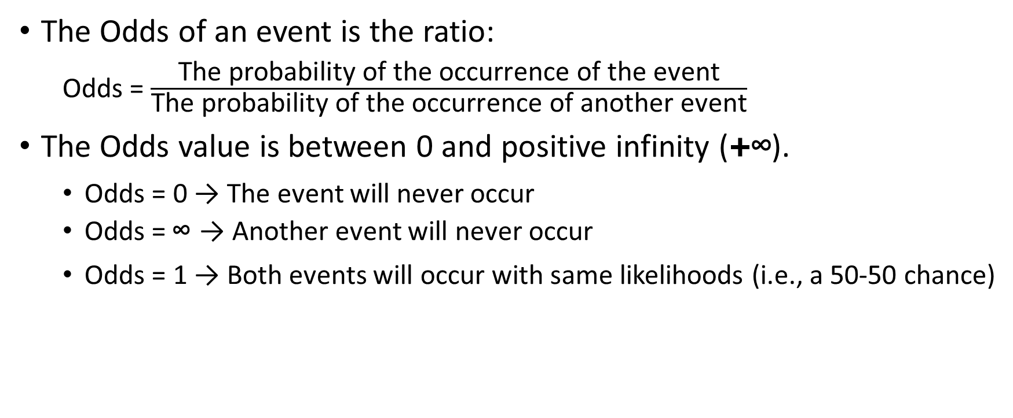
Odds
The Odds of an event is the ratio:
Odds = $\frac{\text{The} \text{probability} \text{of} \text{the} \text{occurrence} \text{of} \text{the} \text{event}}{\text{T}\text{he} \text{probability} \text{of} \text{the} \text{occurrence} \text{of} \text{another} \text{event}}$
The Odds value is between 0 and positive infinity (+∞).
Odds = 0 → The event will never occur
Odds = ∞ → Another event will never occur
Odds = 1 → Both events will occur with same likelihoods (i.e., a 50-50 chance)

Slide 55
Examples of Odds
Prob(Origin = USA) / Prob(Origin = Asia) is the Odds of having a car made in USA versus having a car made in Asia.
Prob(Origin = USA) / Prob(Origin ≠ USA) is the Odds in favor of having a car made in USA versus having a car made elsewhere.
Prob(Origin ≠ USA) / Prob(Origin = USA) is the Odds against having a car made in USA versus having a car made elsewhere.

Slide 56
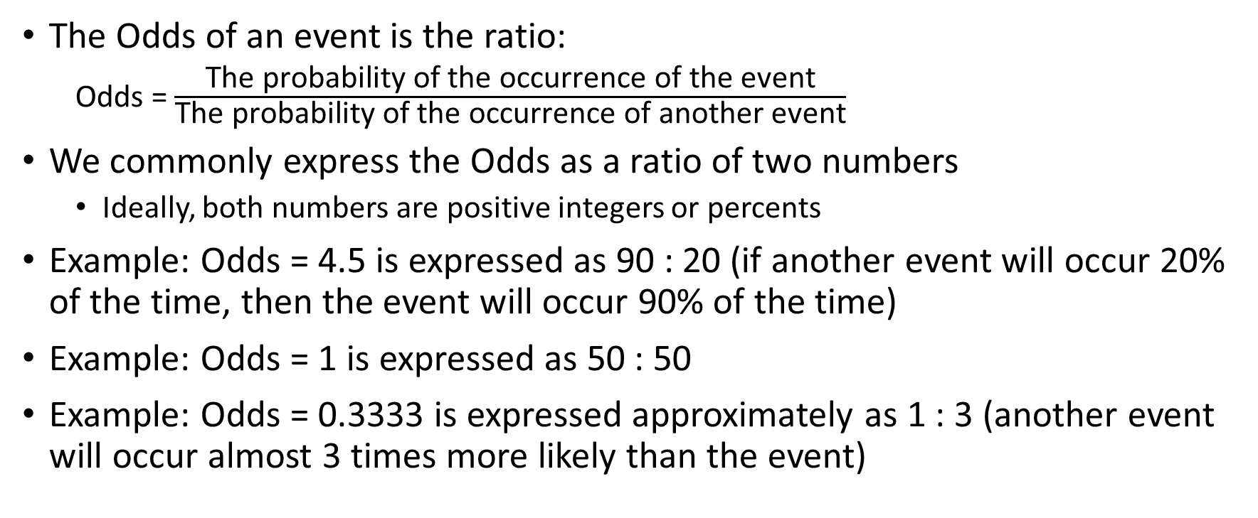
Odds as a Ratio of Two Numbers
The Odds of an event is the ratio:
Odds = $\frac{\text{The} \text{probability} \text{of} \text{the} \text{occurrence} \text{of} \text{the} \text{event}}{\text{T}\text{he} \text{probability} \text{of} \text{the} \text{occurrence} \text{of} \text{another} \text{event}}$
We commonly express the Odds as a ratio of two numbers
Ideally, both numbers are positive integers or percents
Example: Odds = 4.5 is expressed as 90 : 20 (if another event will occur 20% of the time, then the event will occur 90% of the time)
Example: Odds = 1 is expressed as 50 : 50
Example: Odds = 0.3333 is expressed approximately as 1 : 3 (another event will occur almost 3 times more likely than the event)

Slide 57
Odds as a Ratio of Two Numbers
The Odds of winning the $700 million Powerball drawing in August 2017 is 1 in 292 million.
We interpret as the probability of not winning the Powerball is 292 million times of the probability of winning the Powerball.
Suppose the probability of not winning the Powerball is 0.999999, then the probability of winning the Powerball is 0.999999 / 292E6 = 3.81679E-9 = 0.000 000 003 816 79.

Slide 58
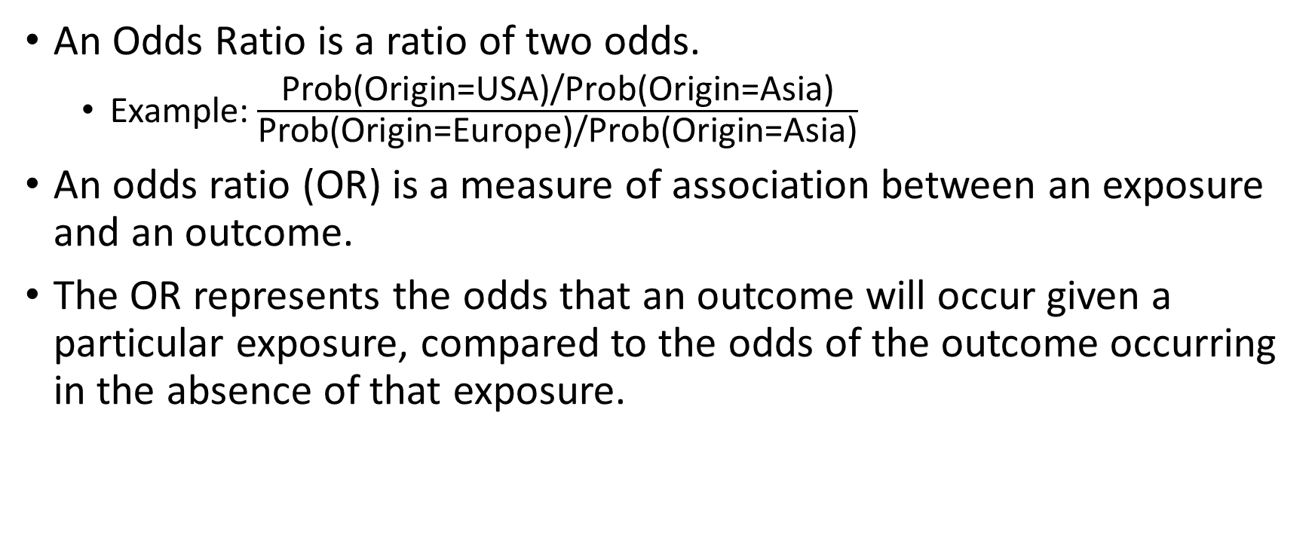
Odds Ratio
An Odds Ratio is a ratio of two odds.
Example: $\frac{\text{Prob}\text{(}\text{Origin}\text{=}\text{USA}\text{)/}\text{Prob}\text{(}\text{Origin}\text{=}\text{Asia}\text{)}}{\text{Pr}\text{ob}\text{(}\text{Origin}\text{=}\text{Europe}\text{)/}\text{Prob}\text{(}\text{Origin}\text{=}\text{Asia}\text{)}}$
An odds ratio (OR) is a measure of association between an exposure and an outcome.
The OR represents the odds that an outcome will occur given a particular exposure, compared to the odds of the outcome occurring in the absence of that exposure.

Slide 59
Odds Ratio
Odds ratios are used to compare the relative odds of the occurrence of the outcome of interest (e.g. disease, loan approval, retained customer), given exposure to the variable of interest (e.g. medical history, credit characteristics, customer experience).
The odds ratio can also be used to determine whether a particular exposure is a risk factor for a particular outcome and to compare the magnitude of various risk factors for that outcome.
OR = 1 implies exposure does not affect the odds of the outcome
OR > 1 implies exposure associated with higher odds of the outcome
OR < 1 implies exposure associated with lower odds of the outcome

Slide 60
Example of Odds Ratio
Suppose the Outcome is Event or Non-Event, and the Exposure is Present or Absent
Cross-tabulate the counts: A, B, C, and D
(A / (A + B)) / (B / (A + B)) = A / B is the Odds in favor of having the Event when the Exposure is Present
(C / (C + D)) / (D / (C + D)) = C / D is the Odds in favor of having the Event when the Exposure is Absent
OR = (A / B) / (C / D)
 |  | Outcome
 |  | Event | Non-Event
Exposure | Present | A | B
 | Absent | C | D

Slide 61
Example of Odds Ratio
 |  | Outcome
 |  | Event | Non-Event
Exposure | Present | 60 | 40
 | Absent | 50 | 50
OR = (60 / 40) / (50 / 50) = 1.5
OR = (50 / 50) / (60 / 40) = 0.6667
OR = (60 / 40) / (60 / 40) = 1
 |  | Outcome
 |  | Event | Non-Event
Exposure | Present | 50 | 50
 | Absent | 60 | 40
 |  | Outcome
 |  | Event | Non-Event
Exposure | Present | 60 | 40
 | Absent | 60 | 40

Slide 62
Odds Ratio in Logistic Model
A common question for the multinomial logistic model is: how can I know the impact on the predicted probabilities when a predictor changes its value, provided all other predictors remain fixed?
The short answer is we cannot.
Well, we can only tell the impact on the odds when a predictor changes its value, provided all other predictors remain the same.
The estimated coefficient of a predictor, say b1, is the estimated increase in the log-odds of the outcome for each unit increase in the value of the predictor.
In other words, the exponentiated regression coefficient (e^{b1}) is the odds ratio associated with a one-unit increase in the predictor.

Slide 63
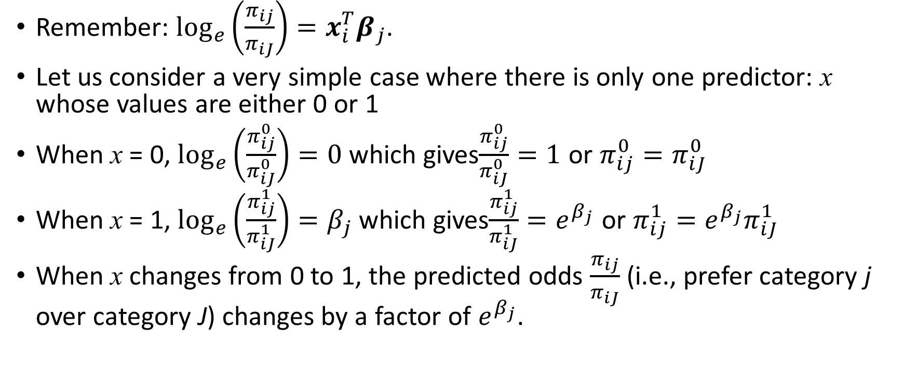
Odds Ratio in Logistic Model
Remember: $\log_{e}\left(\frac{π_{ij}}{π_{iJ}}\right)={x_{i}^{T}β}_{j}$.
Let us consider a very simple case where there is only one predictor: x whose values are either 0 or 1
When x = 0, $\log_{e}\left(\frac{π_{ij}^{0}}{π_{iJ}^{0}}\right)=0$ which gives$\frac{π_{ij}^{0}}{π_{iJ}^{0}}=1$ or $π_{ij}^{0}=π_{iJ}^{0}$
When x = 1, $\log_{e}\left(\frac{π_{ij}^{1}}{π_{iJ}^{1}}\right)=β_{j}$ which gives$\frac{π_{ij}^{1}}{π_{iJ}^{1}}=e^{β_{j}}$ or $π_{ij}^{1}=e^{β_{j}}π_{iJ}^{1}$
When x changes from 0 to 1, the predicted odds $\frac{π_{ij}}{π_{iJ}}$ (i.e., prefer category j over category J) changes by a factor of $e^{β_{j}}$.

Slide 64
Odds Ratio in Logistic Model
Suppose values of the predictor: x changes from $v_{0}$ to $v_{1}$
When x = $v_{0}$, $\log_{e}\left(\frac{π_{ij}^{0}}{π_{iJ}^{0}}\right)=v_{0}β_{j}$ which gives$\frac{π_{ij}^{0}}{π_{iJ}^{0}}=e^{v_{0}β_{j}}$
When x = $v_{1}$, $\log_{e}\left(\frac{π_{ij}^{1}}{π_{iJ}^{1}}\right)=v_{1}β_{j}$ which gives$\frac{π_{ij}^{1}}{π_{iJ}^{1}}=e^{v_{1}β_{j}}$
When x changes from $v_{0}$ to $v_{1}$, the predicted odds $\frac{π_{ij}}{π_{iJ}}$ (i.e., prefer category j over category J) changes by a factor of $e^{{\left(v_{1}−v_{0}\right)β}_{j}}$.
That is, ${\left(\frac{π_{ij}^{1}}{π_{iJ}^{1}}\right)}/{\left(\frac{π_{ij}^{0}}{π_{iJ}^{0}}\right)}=e^{{\left(v_{1}−v_{0}\right)β}_{j}}$

Slide 65
Odds Ratio
For interval predictors, the odds ratio estimates are for unit change in these predictors.
For EngineSize, the unit change is 1 liter.
For HorsePower, the unit change is 1 hp.
For Length, the unit change is 1 inch.
For Weight, the unit change is 1 pound.
For categorical predictors, the change is from one category to another category
For DriveTrain, it is the change from FWD to RWD

Slide 66
Odds Ratio
Suppose a car has RWD drive train, E liters engine size, H horsepower, L inches long, and weighs W pounds.
If the drive train is AWD instead while all other predictors remain the same, then how does this change affect the logits?

Slide 67
Odds Ratio
Model Parameter Estimates:
0 1
const -11.420162 -5.229709
DriveTrain_AWD 15.777436 -2.634106
DriveTrain_FWD 15.651582 -1.290062
DriveTrain_RWD 16.650842 -1.305550
EngineSize -1.397881 2.400626
Horsepower 0.021045 -0.031438
Length -0.063234 0.033081
Weight 0.001804 -0.000241
Origin = cars['Origin'].astype('category')
y = Origin
y_category = y.cat.categories
DriveTrain = cars[['DriveTrain']].astype('category')
X = pandas.get_dummies(DriveTrain)
X = X.join(cars[['EngineSize', 'Horsepower', 'Length', 'Weight']])
X = api.add_constant(X, prepend=True)
logit = api.MNLogit(y, X)
print("Name of Target Variable:", logit.endog_names)
print("Name(s) of Predictors:", logit.exog_names)
thisFit = logit.fit(method='newton', full_output = True, maxiter = 100, tol = 1e-8)
thisParameter = thisFit.params
print("Model Parameter Estimates:\n", thisFit.params)
Week 7 Cars Logistic.py

Slide 68
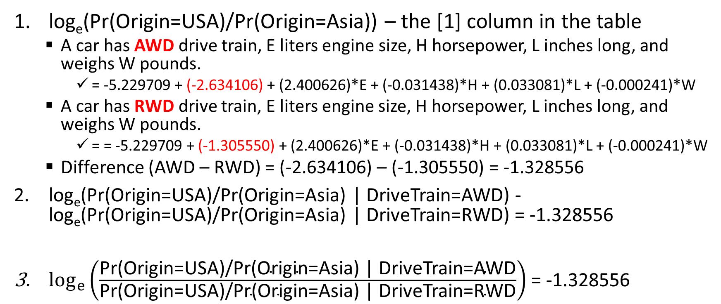
Odds Ratio
Spot the differences?
log_{e}(Pr(Origin=USA)/Pr(Origin=Asia)) – the [1] column in the table
A car has AWD drive train, E liters engine size, H horsepower, L inches long, and weighs W pounds.
= -5.229709 + (-2.634106) + (2.400626)*E + (-0.031438)*H + (0.033081)*L + (-0.000241)*W
A car has RWD drive train, E liters engine size, H horsepower, L inches long, and weighs W pounds.
= = -5.229709 + (-1.305550) + (2.400626)*E + (-0.031438)*H + (0.033081)*L + (-0.000241)*W
Difference (AWD – RWD) = (-2.634106) – (-1.305550) = -1.328556
log_{e}(Pr(Origin=USA)/Pr(Origin=Asia) | DriveTrain=AWD) - log_{e}(Pr(Origin=USA)/Pr(Origin=Asia) | DriveTrain=RWD) = -1.328556
$\log_{e}\left(\frac{\text{Pr}\text{(}\text{Origin}\text{=}\text{USA}\text{)/}\text{Pr}\text{(}\text{Origin}\text{=}\text{Asia}\text{) | }\text{DriveTrain}\text{=}\text{AWD}}{\text{Pr}\text{(}\text{Origin}\text{=}\text{USA}\text{)/}\text{Pr}\text{(}\text{Origin}\text{=}\text{Asia}\text{) | }\text{DriveTrain}\text{=}\text{RWD}}\right)$ = -1.328556

Slide 69
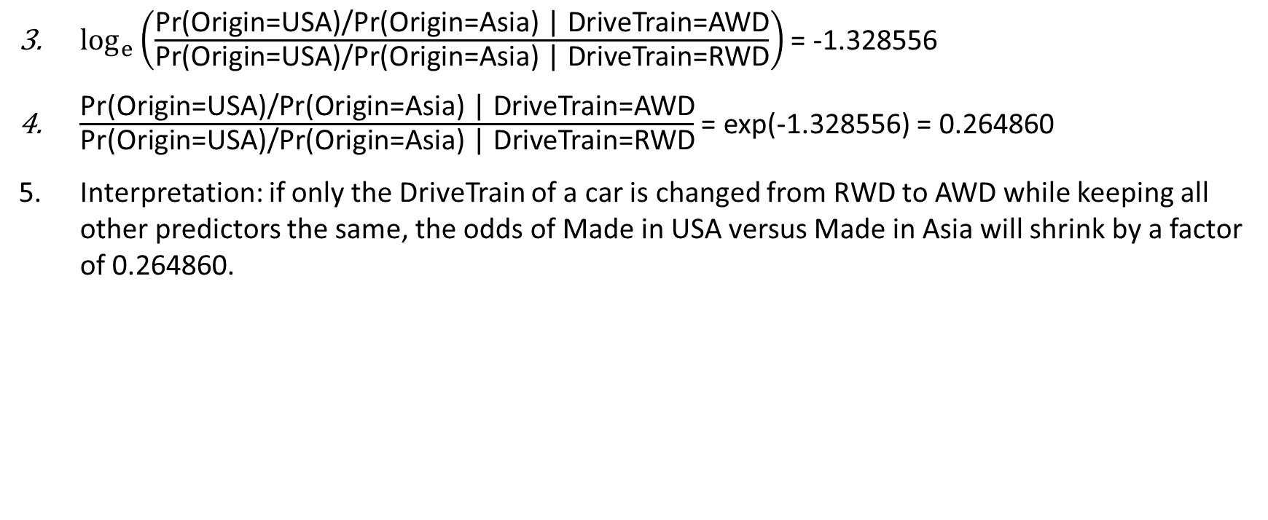
Odds Ratio
$\log_{e}\left(\frac{\text{Pr}\text{(}\text{Origin}\text{=}\text{USA}\text{)/}\text{Pr}\text{(}\text{Origin}\text{=}\text{Asia}\text{) | }\text{DriveTrain}\text{=}\text{AWD}}{\text{Pr}\text{(}\text{Origin}\text{=}\text{USA}\text{)/}\text{Pr}\text{(}\text{Origin}\text{=}\text{Asia}\text{) | }\text{DriveTrain}\text{=}\text{RWD}}\right)$ = -1.328556
$\frac{\text{Pr}\text{(}\text{Origin}\text{=}\text{USA}\text{)/}\text{Pr}\text{(}\text{Origin}\text{=}\text{Asia}\text{) | }\text{DriveTrain}\text{=}\text{AWD}}{\text{Pr}\text{(}\text{Origin}\text{=}\text{USA}\text{)/}\text{Pr}\text{(}\text{Origin}\text{=}\text{Asia}\text{) | }\text{DriveTrain}\text{=}\text{RWD}}$ = exp(-1.328556) = 0.264860
Interpretation: if only the DriveTrain of a car is changed from RWD to AWD while keeping all other predictors the same, the odds of Made in USA versus Made in Asia will shrink by a factor of 0.264860.

Slide 70
Odds Ratio
Obs. Percents | Origin
DriveTrain | Asia | Europe | USA | Total
AWD | 36.96 | 39.13 | 23.91 | 100%
FWD | 43.81 | 16.37 | 39.82 | 100%
RWD | 22.73 | 45.45 | 31.82 | 100%
If the odds of Made in USA versus Made in Asia for RWD drive train is 31.82 : 22.73 (i.e. 1.3999120), then the same odds for AWD drive train is shrunk to (31.82/22.73) * 0.264860 = 0.370780.
The observed odds of Made in USA versus Made in Asia for AWD drive train is 23.91 : 36.96 = 0.64691558. The Logistic model suggests that the actual odds should be 36.96 * 0.370780 : 36.96 = 13.70 : 36.96 (USA : Asia).
The Logistic model suggests that having AWD drive train makes the car even more likely to be made in Asia than USA compared to a car with RWD drive.

Slide 71
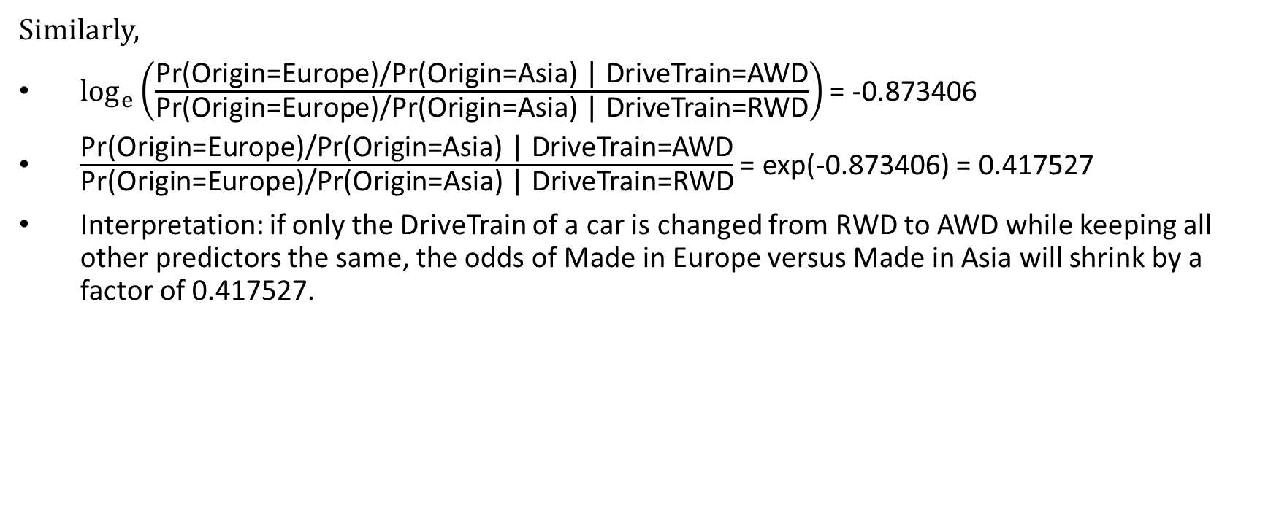
Odds Ratio
Similarly,
$\log_{e}\left(\frac{\text{Pr}\text{(}\text{Origin}\text{=}\text{Europe}\text{)/}\text{Pr}\text{(}\text{Origin}\text{=}\text{Asia}\text{) | }\text{DriveTrain}\text{=}\text{AWD}}{\text{Pr}\text{(}\text{Origin}\text{=}\text{Europe}\text{)/}\text{Pr}\text{(}\text{Origin}\text{=}\text{Asia}\text{) | }\text{DriveTrain}\text{=}\text{RWD}}\right)$ = -0.873406
$\frac{\text{Pr}\text{(}\text{Origin}\text{=}\text{Europe}\text{)/}\text{Pr}\text{(}\text{Origin}\text{=}\text{Asia}\text{) | }\text{DriveTrain}\text{=}\text{AWD}}{\text{Pr}\text{(}\text{Origin}\text{=}\text{Europe}\text{)/}\text{Pr}\text{(}\text{Origin}\text{=}\text{Asia}\text{) | }\text{DriveTrain}\text{=}\text{RWD}}$ = exp(-0.873406) = 0.417527
Interpretation: if only the DriveTrain of a car is changed from RWD to AWD while keeping all other predictors the same, the odds of Made in Europe versus Made in Asia will shrink by a factor of 0.417527.

Slide 72
Odds Ratio
Obs. Percents | Origin
DriveTrain | Asia | Europe | USA | Total
AWD | 36.96 | 39.13 | 23.91 | 100%
FWD | 43.81 | 16.37 | 39.82 | 100%
RWD | 22.73 | 45.45 | 31.82 | 100%
If the odds of Made in Europe versus Made in Asia for RWD drive train is 45.45 : 22.73 (i.e. 1.9995600), then the same odds for ALL drive train is shrunk to (45.45/22.73) * 0.417527 = 0.834870.
The observed odds of Made in Europe versus Made in Asia for ALL drive train is 39.13 : 36.96 = 1.05871212. The Logistic model suggests that the actual odds should be 36.96 * 0.834870 : 36.96 = 30.86 : 36.96 (Europe : Asia).
The Logistic model suggests that having AWD drive train makes the car even more likely to be made in Asia than Europe compared to a car with RWD drive.

Slide 73
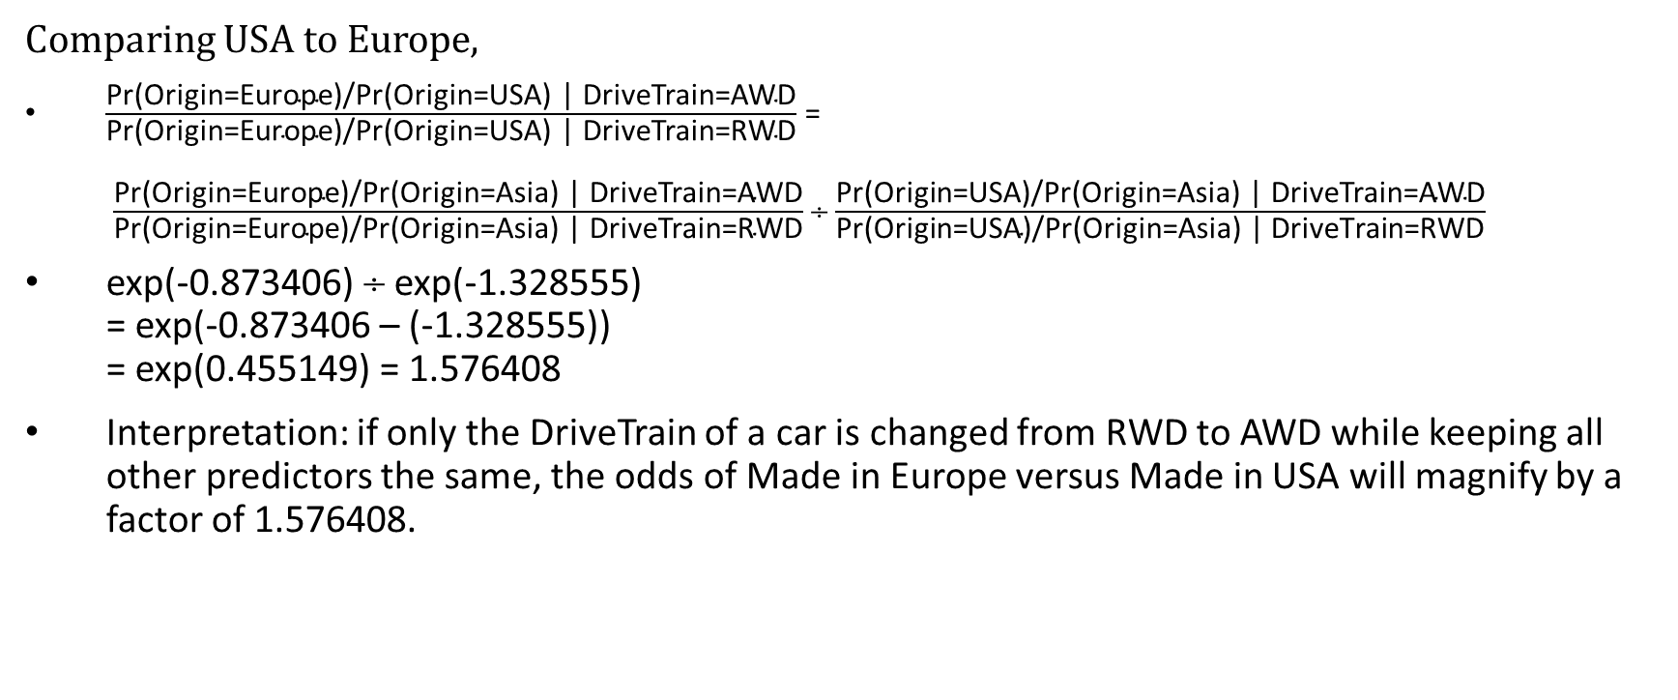
Odds Ratio
Comparing USA to Europe,
$\frac{\text{Pr}\text{(}\text{Origin}\text{=}\text{Europe}\text{)/}\text{Pr}\text{(}\text{Origin}\text{=}\text{USA}\text{) | }\text{DriveTrain}\text{=}\text{AWD}}{\text{Pr}\text{(}\text{Origin}\text{=}\text{Europe}\text{)/}\text{Pr}\text{(}\text{Origin}\text{=}\text{USA}\text{) | }\text{DriveTrain}\text{=}\text{RWD}}$ = $\frac{\text{Pr}\text{(}\text{Origin}\text{=}\text{Europe}\text{)/}\text{Pr}\text{(}\text{Origin}\text{=}\text{Asia}\text{) | }\text{DriveTrain}\text{=}\text{AWD}}{\text{Pr}\text{(}\text{Origin}\text{=}\text{Europe}\text{)/}\text{Pr}\text{(}\text{Origin}\text{=}\text{Asia}\text{) | }\text{DriveTrain}\text{=}\text{RWD}}$  $\frac{\text{Pr}\text{(}\text{Origin}\text{=}\text{USA}\text{)/}\text{Pr}\text{(}\text{Origin}\text{=}\text{Asia}\text{) | }\text{DriveTrain}\text{=}\text{AWD}}{\text{Pr}\text{(}\text{Origin}\text{=}\text{USA}\text{)/}\text{Pr}\text{(}\text{Origin}\text{=}\text{Asia}\text{) | }\text{DriveTrain}\text{=}\text{RWD}}$
exp(-0.873406)  exp(-1.328555) = exp(-0.873406 – (-1.328555)) = exp(0.455149) = 1.576408
Interpretation: if only the DriveTrain of a car is changed from RWD to AWD while keeping all other predictors the same, the odds of Made in Europe versus Made in USA will magnify by a factor of 1.576408.

Slide 74
Odds Ratio
Obs. Percents | Origin
DriveTrain | Asia | Europe | USA | Total
AWD | 36.96 | 39.13 | 23.91 | 100%
FWD | 43.81 | 16.37 | 39.82 | 100%
RWD | 22.73 | 45.45 | 31.82 | 100%
If the odds of Made in Europe versus Made in USA for RWD drive train is 45.45 : 31.82 (i.e. 1.42834695), then the same odds for AWD drive train is magnified to (45.45/31.82) * 1.576408 = 2.251658.
The observed odds of Made in Europe versus Made in USA for AWD drive train is 39.13 : 23.91 = 1.63655374. The Logistic model suggests that the actual odds should be 23.91 * 2.251658 : 23.91 = 53.84 : 23.91 (Europe : USA).
The Logistic model suggests that having AWD drive train makes the car even more likely to be made in Europe than USA compared to a car with RWD drive.

Slide 75
Multinomial Logistic Model: Summary
The logistic model describes the relationship between target probabilities with values of predictors as mathematical formulas
You can optimize target probabilities by finding the optimal set of values of predictors
The logistic model has better computational performance when predictors are all categorical

Slide 76
Assignment 3
Assignment 3 will be posted on Friday, March 1, 2019
Due date is 11:59 pm on Monday, March 11, 2019

